Slide 2
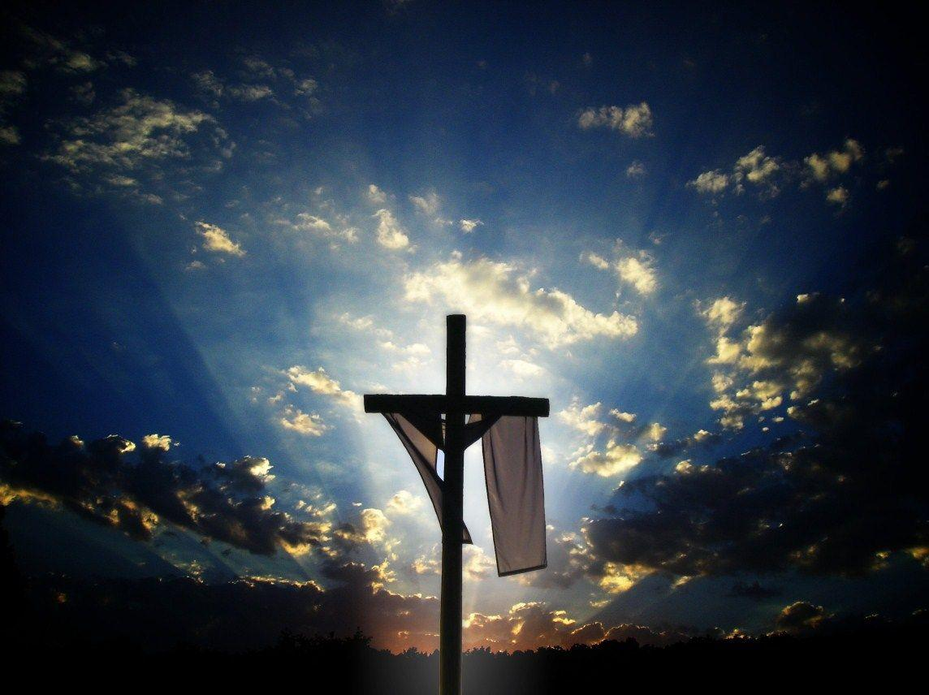
Easter-April 21,2019

Slide 3
Acts 12:1-4

Slide 4
Why should we
do anything for Lent?

Slide 5
“for dust you are and to dust you will return.”
Genesis 3:19

Slide 6
Ecclesiastes 3:19-20
“All come from dust, and to dust all return.”
Ecclesiastes 3:20

Slide 7
Job 42:5-6
“I despise myself and repent in dust and ashes” Job 42:6

Slide 8
Ezekiel 8:1-9:6
“do not touch anyone who has the mark”
Genesis 9:6

Slide 9
Romans 2:25-29

Slide 10
“for dust you are and to dust you will return.”
Genesis 3:19

Slide 11
Joel 2:12-19

Slide 12
God changing us…
…and the lives of others

