Slide 1
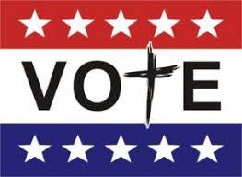
Why Should Christians

Slide 2

Why Should Christians Vote?
“The right to vote in a free country is a gift from God.
We must use the voice we have, or we risk losing it.”
-Franklin Graham
Why Christians Must Vote This Fall
May 14, 2018

Slide 3

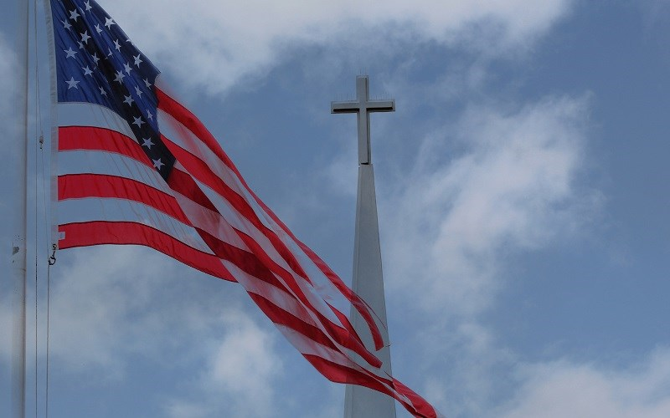
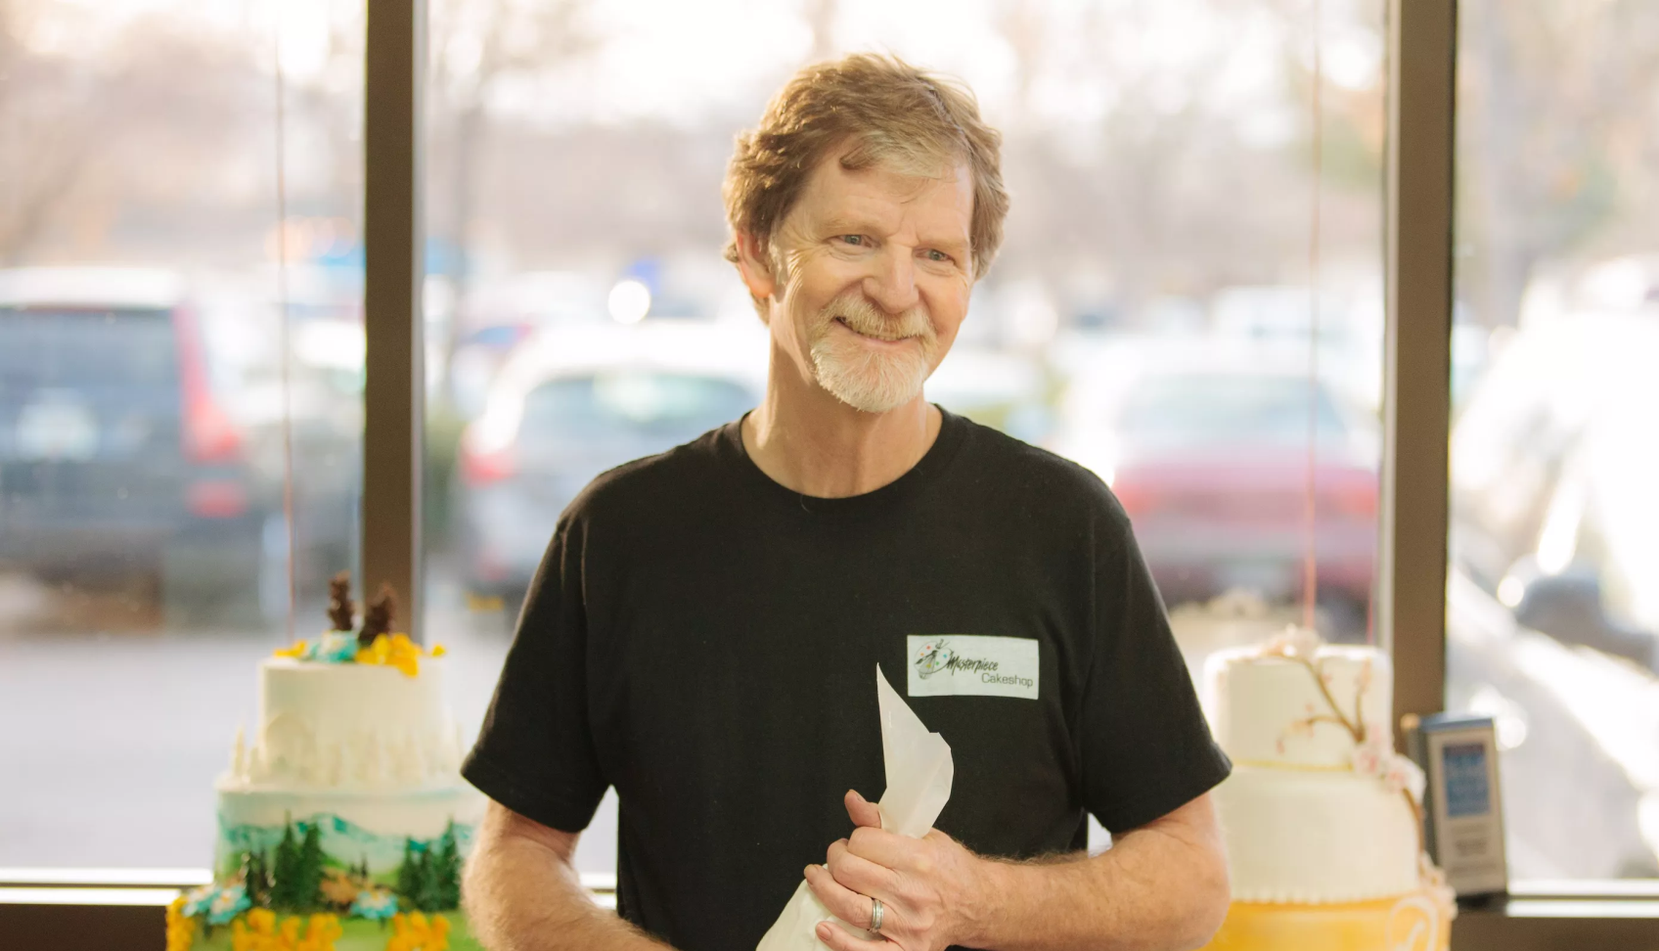
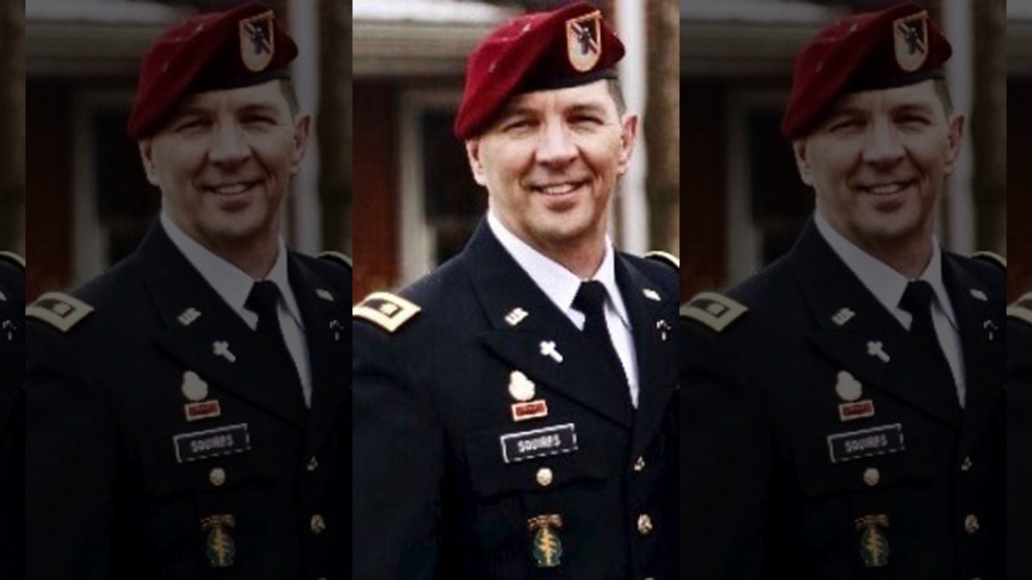
Why Should Christians Vote?
Army Chaplain Accused of Discriminating Against LGBT Couple by Rescheduling A Marriage Retreat
Colorado Baker Jack Phillips Targeted Again for Refusing to Make a Custom Cake
Bible Banned from Billboard in California
Notes:
Chaplain Scott Squires in Ft. Bragg, N.C.
-Declined to conduct a marriage retreat for same-sex couples.
-Violated his religious beliefs
-He must follow the guidelines of his endorsing agency (North American Mission Board of SBC)
Army investigator recommended that Squires be found guilty of “dereliction of duty”-a court martial offense that could result in prison time
Outcome
All charges dropped
“The US Military is no place for anti-religious hostility against its own chaplains”
“Chaplains do not have to give up 1st amendment rights to serve their fellow soldiers”
“Cases like this, and the investigation that followed, demonstrate a waste of funds and resources in the name of political correctness.”
“It is imperitive that the military and its resources remain focused on the task at hand—defending this country, here and abroad”

Slide 4
Why Should Christians Vote?
Mark 12:14a
They came to him and said, “Teacher, we know that you are a man of integrity. You aren’t swayed by others, because you pay no attention to who they are; but you teach the way of God in accordance with the truth.

Slide 5
Why Should Christians Vote?
Mark 12:14b-15
Is it right to pay the imperial tax to Caesar or not? Should we pay or shouldn’t we?” But Jesus knew their hypocrisy. “Why are you trying to trap me?” he asked. “Bring me a denarius and let me look at it.”

Slide 6
Why Should Christians Vote?
Mark 12:16
They brought the coin, and he asked them, “Whose image is this? And whose inscription?”
“Caesar’s,” they replied.

Slide 7
Why Should Christians Vote?
Mark 12:17
Then Jesus said to them, “Give back to Caesar what is Caesar’s and to God what is God’s.”
And they were amazed at him.
Notes:
Give back
-to pay off, discharge tribute and other dues to the government
What
-the cause or interests, the purposes, due to Caesar as opposed to
the cause or interests, the purposes due to God
Amazed
-to wonder or marvel greatly at one
-to wonder at, be amazed (marvel), i.e. astonished out of one's senses; awestruck, "wondering very greatly"; to cause "wonder; . . . to regard with amazement, and with a suggestion of beginning to speculate on the matter"

Slide 8

Why Should Christians Vote?
We show love for our neighbors and our community
God holds us accountable and responsible for those things He has given us charge of
It gives us a voice for the vulnerable and helps us to spread the gospel

Slide 9
Why Should Christians Vote?
We show love for our neighbors and our community
Matthew 22:37-39
“Love your neighbor as yourself.”

Slide 10

Why Should Christians Vote?
God holds us accountable and responsible for those things He has given us charge of

Slide 11
Why Should Christians Vote?
Romans 13:1-3 MSG
Be a good citizen. All governments are under God. Insofar as there is peace and order, it’s God’s order. So live responsibly as a citizen. If you’re irresponsible to the state, then you’re irresponsible with God, and God will hold you responsible. Duly constituted authorities are only a threat if you’re trying to get by with something. Decent citizens should have nothing to fear.

Slide 12
Why Should Christians Vote?
Romans 13:4-7

Slide 13
Why Should Christians Vote?
It gives us a voice for the vulnerable and helps us to spread the Gospel
Matthew 25:31-46
“For I was hungry,…was thirsty,…was a stranger,…needed clothes,…was sick,…was in prison,…”

Slide 14

Make sure that the values, principles, and plan of the person or proposition that you are voting for is in line with God and His principles

Slide 15
