Slide 1

Reaching the Nations
Through Our Giving

Slide 2
Matthew 28:19-20
Therefore go and make disciples of all nations, baptizing them in the name of the Father and of the Son and of the Holy Spirit, and teaching them to obey everything I have commanded you. And surely I am with you always, to the very end of the age.”
Notes:
Go-
to lead over, carry over, transfer
to pursue the journey on which one has entered, to continue on one's journey
to depart from life
to follow one, that is: become his adherent
to lead or order one's life
Make disciples-
To teach, instruct
Of all nations-(Gk. Ethnos)
-a multitude living together
-a multitude of individuals of the same nature or genus
-a tribe, nation, people group
-in the OT, foreign nations not worshipping the true God, pagans, Gentiles
-Gentile Christians

Slide 3
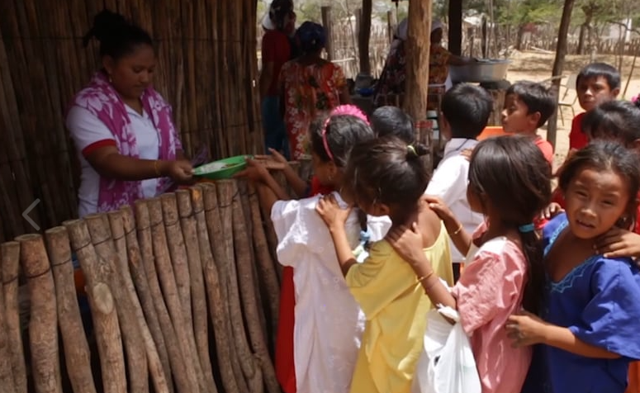
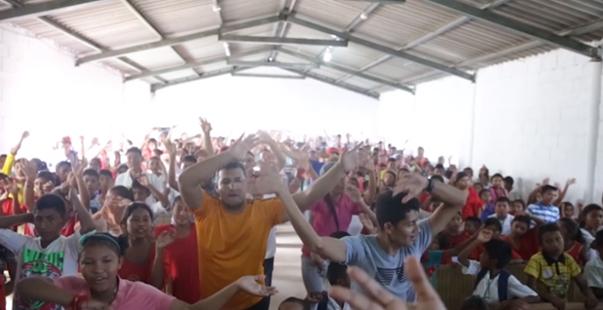
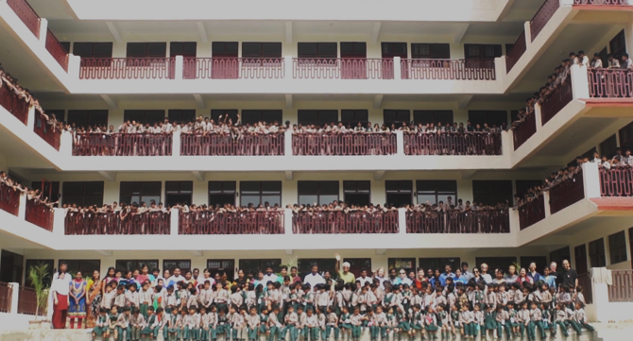
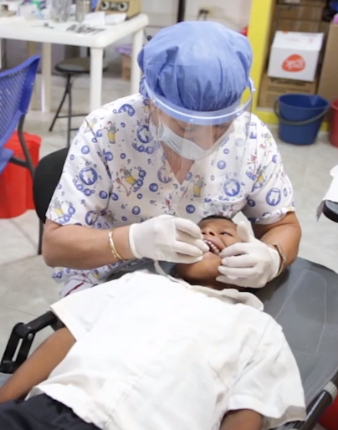
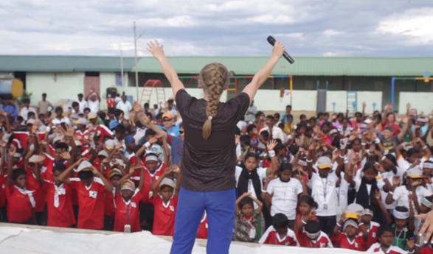

Slide 4
Mark 16:15-16
He said to them, “Go into all the world and preach the gospel to all creation. Whoever believes and is baptized will be saved, but whoever does not believe will be condemned.”
Notes:
Go into
All the world (gk. Kosmos)
-the circle of the earth, the earth
Preach the gospel
-publicly proclaim the gospel and matters pertaining to it
Matthew Henry “Commentary on Mark 16”
to every human creature that is capable of receiving it. "Inform them concerning Christ, the history of his life, and death, and resurrection; instruct them in the meaning and intention of these, and of the advantages which the children of men have, or may have, hereby; and invite them, without exception, to come and share in them. This is gospel. Let this be preached in all places, to all persons.' These eleven men could not themselves preach it to all the world, much less to every creature in it; but they and the other disciples, seventy in number, with those who should afterward to be added to them, must disperse themselves several ways, and, wherever they went, carry the gospel along with them. They must send others to those places whither they could not go themselves, and, in short, make it the business of their lives to send those glad tidings up and down the world with all possible fidelity and care, not as an amusement or entertainment, but as a solemn message from God to men, and an appointed means of making men happy. "Tell as many as you can, and bid them tell others; it is a message of universal concern, and therefore, ought to have a universal welcome, because it gives a universal welcome.'

Slide 5
Mark 16:20
Then the disciples went out and preached everywhere, and the Lord worked with them and confirmed his word by the signs that accompanied it.

Slide 6
God has directed us to be missionaries whether we serve in missions here or in other parts of the world

Slide 7
God uses the financial support and resources of faithful saints to do the work of missions
Notes:
Luke 8:1-3
After this, Jesus traveled about from one town and village to another, proclaiming the good news of the kingdom of God. The Twelve were with him, ² and also some women who had been cured of evil spirits and diseases: Mary (called Magdalene) from whom seven demons had come out; ³ Joanna the wife of Chuza, the manager of Herod’s household; Susanna; and many others. These women were helping to support them out of their own means.
-Widow who provided for Elijah
-Persian king who provided for Nehemiah to build the wall

Slide 8
2 Corinthians 8:1-5
And now, brothers and sisters, we want you to know about the grace that God has given the Macedonian churches. In the midst of a very severe trial, their overflowing joy and their extreme poverty welled up in rich generosity.

Slide 9
2 Corinthians 8:1-5
For I testify that they gave as much as they were able, and even beyond their ability. Entirely on their own, they urgently pleaded with us for the privilege of sharing in this service to the Lord’s people. And they exceeded our expectations: They gave themselves first of all to the Lord, and then by the will of God also to us.
Notes:
WLACC Missions Giving in 2017:
-Set aside $9,363 (10% of total revenue) for Missions
-Gave $936 for Home Missions
-Gave $8,427 for Foreign Missions

Slide 10

https://vimeo.com/242136982

Slide 12


Slide 14
1 Corinthians 16:1-2
Now about the collection for the Lord’s people: Do what I told the Galatian churches to do. On the first day of every week, each one of you should set aside a sum of money in keeping with your income, saving it up, so that when I come no collections will have to be made.

Slide 15
Philippians 4:18-19
…I am amply supplied, now that I have received from Epaphroditus the gifts you sent. They are a fragrant offering, an acceptable sacrifice, pleasing to God. And my God will meet all your needs according to the riches of his glory in Christ Jesus.

