Slide 1
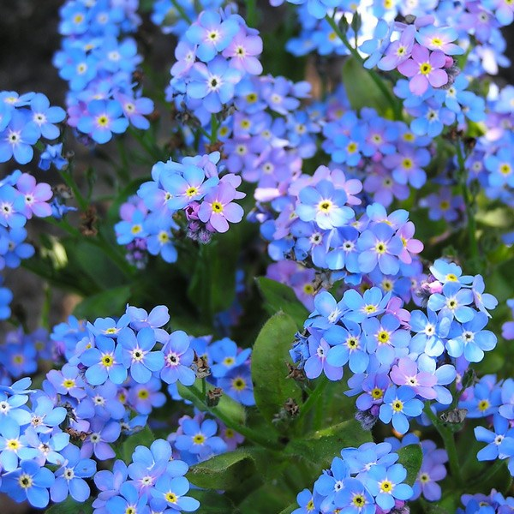
God Will Not Forget

Slide 2
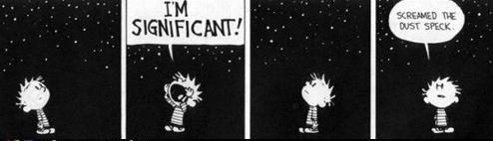
God Will Not Forget
Quest for Significance
Calvin and Hobbes for October 17, 2013
By Bill Waterson
Notes:
What is our significance in our world and our universe?
Are we just a speck that doesn’t matter?
Does my life really make a difference?
Does God really care or pay attention to what we do or say to others?

Slide 3
God Will Not Forget
Hebrews 6:10 (NIV)
God is not unjust; he will not forget your work and the love you have shown him as you have helped his people and continue to help them.
Notes:
Not unjust
-(No, absolutely not) + (one who violates or has violated justice, unrighteous, sinful, deceitful)
Not forget
-to escape notice, to be willingly ignorant, neglectful, or unaware; no longer caring for
Work (Gk. ergon)
-toil (as an effort or occupation); by implication, an act:—deed, doing, labor, work.
-business, employment, that with which anyone is occupied
-what you have done with your hands
The love (Gk. Agape)
-affection, good will, love, benevolence, brotherly love
Have shown
-to point out, to show, demonstrate, prove, whether by arguments or by acts
to manifest, display, put forth
Helped
-having ministered
to provide, take care of, distribute, the things necessary to sustain life
to take care of the poor and the sick
to relieve one’s necessities (e.g. by collecting alms)
Them (Gk. Hagios)
-the saints, those set apart for God
-

Slide 4
God Will Not Forget
Hebrews 6:11
We want each of you to show this same diligence to the very end, so that what you hope for may be fully realized.

Slide 5
God Will Not Forget
Hebrews 6:12
We do not want you to become lazy, but to imitate those who through faith and patience inherit what has been promised.

Slide 6
God Will Not Forget
2 Timothy 4:7-8
I have fought the good fight, I have finished the race, I have kept the faith. Now there is in store for me the crown of righteousness, which the Lord, the righteous Judge, will award to me on that day—and not only to me, but also to all who have longed for his appearing.

Slide 7
God Will Not Forget
Hebrews 13:1-2
Keep on loving one another as brothers and sisters. ² Do not forget to show hospitality to strangers, for by so doing some people have shown hospitality to angels without knowing it.

Slide 8
God Will Not Forget
Hebrews 13:16
And do not forget to do good and to share with others, for with such sacrifices God is pleased.

Slide 9
God Will Not Forget
Matthew 25:31-46
Parable of the sheep and the
goats

Slide 10
God Will Not Forget
Matthew 25:40
The King will reply, “I tell you the truth, whatever you did for one of the least of these brothers of mine, you did for me.”
Notes:
Brother of mine (Gk. adelphos)
-Christians, fellow believers
-Jesus called those who are made holy brothers (Hebrews 2:11-12)

Slide 11
God Will Not Forget
Small Church Advantage
The smaller the group, the more likely there will be a higher percentage of members engaged in the goals of the team.
-Karl Vater “Engagement: A Small Church Advantage We Need to Cultivate”
Sept. 27, 2018, Christianity Today Blog
Notes:
Brother of mine (Gk. adelphos)
-Christians, fellow believers
-Jesus called those who are made holy brothers (Hebrews 2:11-12)

Slide 12
God Will Not Forget
Small Church Advantage
Church health is promoted and measured on how deeply people are engaged in ministry, fellowship, and other aspects of church life and community
-Karl Vater “Engagement: A Small Church Advantage We Need to Cultivate”
Sept. 27, 2018, Christianity Today Blog
Notes:
Brother of mine (Gk. adelphos)
-Christians, fellow believers
-Jesus called those who are made holy brothers (Hebrews 2:11-12)

Slide 13
God Will Not Forget
Small Church Advantage
We need to help people to get engaged in relationships:
With Jesus
With each other
With the people in our
neighborhoods who need to
be reached
-Karl Vater “Engagement: A Small Church Advantage We Need to Cultivate”
Sept. 27, 2018, Christianity Today Blog
Notes:
Brother of mine (Gk. adelphos)
-Christians, fellow believers
-Jesus called those who are made holy brothers (Hebrews 2:11-12)

