Slide 1
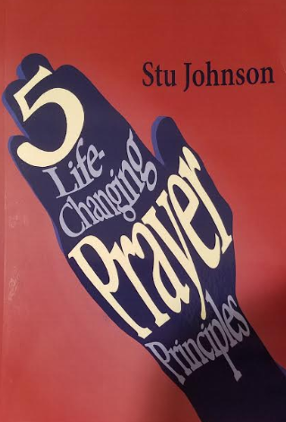
Excerpts from (used by permission of author):
5 Life-Changing Prayer Principles by Stu Johnson
© Stu Johnson 2018 Optasia Books, PO Box 2011, Friendswood, TX 77549

Slide 2
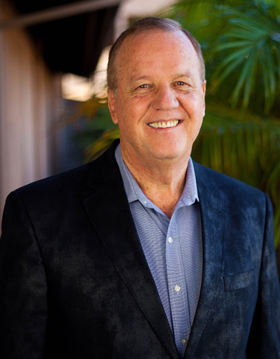
5 POWERFUL PRAYERS PRINCIPLES
© Stu Johnson 2018
Executive Adminstrator for Grace International Churches and Ministries
  More than 3000 churches in more than 100 countries
Air Force officer for 30 years
  Last position in 1999-Colonel over 6000 military and civilians with 30 subordinate commands.

Slide 3
5 POWERFUL PRAYERS PRINCIPLES
5 Principles to help you develop a vibrant, robust prayer life
Discover that prayer will:
Change your life
Connect you with God
Help you to live in His will

Slide 4
5 LIFE-CHANGING PRAYER PRINCIPLES
5 Things You Should Seek in Prayer:
His Purity
His Purpose
His Presence
His Power
His Protection

Slide 5
5 LIFE-CHANGING PRAYER PRINCIPLES
5 Things You Should Seek in Prayer:
His Purity
  Ask God to search your heart and reveal any sin (Ps. 139:23-24)
  Allow His correction/instruction
  Pray for fruit of the Spirit to increase in your life
Notes:
Ps. 139:23-24
Search me, God, and know my heart;
test me and know my anxious thoughts.
See if there is any offensive way in me,
and lead me in the way everlasting.

Slide 6
5 LIFE-CHANGING PRAYER PRINCIPLES
5 Things You Should Seek in Prayer:
His Purpose
    Present your Body to Him each morning
    Choose to fear the Lord
    Pray the prayer of Jabez (1 Chron. 4:10)
Notes:
1 Chron. 4:10
Jabez cried out to the God of Israel, “Oh, that you would bless me and enlarge my territory! Let your hand be with me, and keep me from harm so that I will be free from pain.” And God granted his request.

Slide 7
5 LIFE-CHANGING PRAYER PRINCIPLES
5 Things You Should Seek in Prayer:
His Presence
Ask God to cover your life with His names revealed in Scripture
Praise and thank God for each of the names

Slide 8
5 LIFE-CHANGING PRAYER PRINCIPLES
5 Things You Should Seek in Prayer:
His Power
Pray to be filled with the Holy Spirit each day
Pray for God’s 7-fold Spirit to fill you (Isa. 11:1-2)
Ask for God’s gifts to operate in your life today (1 Cor. 12:7-10)
Notes:
Isa. 11:1-2
A shoot will come up from the stump of Jesse;
from his roots a Branch will bear fruit.
The Spirit of the Lord will rest on him—
the Spirit of wisdom and of understanding,
the Spirit of counsel and of might,
the Spirit of the knowledge and fear of the Lord

Slide 9
5 LIFE-CHANGING PRAYER PRINCIPLES
5 Things You Should Seek in Prayer:
His Protection
Ask for God to protect you with the armor of God (Eph. 6:10-18)
Put on God’s armor, piece by piece, starting at the top of your head
Notes:
Eph. 6:10-18
¹⁰ Finally, be strong in the Lord and in his mighty power. ¹¹ Put on the full armor of God, so that you can take your stand against the devil’s schemes. ¹² For our struggle is not against flesh and blood, but against the rulers, against the authorities, against the powers of this dark world and against the spiritual forces of evil in the heavenly realms. ¹³ Therefore put on the full armor of God, so that when the day of evil comes, you may be able to stand your ground, and after you have done everything, to stand. ¹⁴ Stand firm then, with the belt of truth buckled around your waist, with the breastplate of righteousness in place, ¹⁵ and with your feet fitted with the readiness that comes from the gospel of peace. ¹⁶ In addition to all this, take up the shield of faith, with which you can extinguish all the flaming arrows of the evil one. ¹⁷ Take the helmet of salvation and the sword of the Spirit, which is the word of God.
¹⁸ And pray in the Spirit on all occasions with all kinds of prayers and requests. With this in mind, be alert and always keep on praying for all the Lord’s people.

Slide 10
5 LIFE-CHANGING PRAYER PRINCIPLES
5 Things You Should Seek in Prayer:
His Purity
His Purpose
His Presence
His Power
His Protection
After praying the 5 P’s, pray prayers of petition for others

