Slide 1
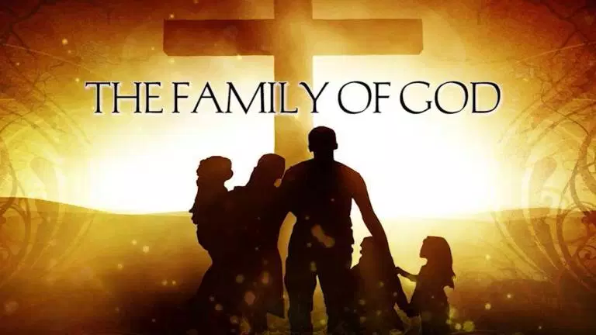

Slide 2


Slide 3
The Family of God
Family Function
Fun
Be yourself
Acceptance
Sense of Belonging
Purpose and Roles
Food!!!

Slide 4
The Family of God
The word “family” is mentioned 205 times in Bible (NIV)
184 times in Old Testament
21 times in the New Testament

Slide 5
The Family of God
Three words are used for “family”
Old Testament (Hebrew)
eleph
bayith
New Testament (Greek)
patria
Notes:
eleph- cattle, oxen, family; from root word to teach, learn, utter, tame
(male)
bayith- house
(male) home, house as containing a family
household, family
those belonging to the same household
family of descendants, descendants as organized body
patria- lineage running back to some progenitor, ancestry
(female) a nation or tribe
a group of families, all those who in a given people lay claim to a common origin
family, in a wider sense, nation, people
from male Gk. root pater-father, parent, The Father
nourisher, protector, upholder

Slide 6
The Family of God
Ephesians 3:14-17
For this reason I kneel before the Father, from whom every family in heaven and on earth derives its name. I pray that out of his glorious riches he may strengthen you with power through his Spirit in your inner being, ¹⁷ so that Christ may dwell in your hearts through faith.
Notes:
patria- lineage running back to some progenitor, ancestry
(female) a nation or tribe
a group of families, all those who in a given people lay claim to a common origin
family, in a wider sense, nation, people
from male Gk. root pater-father, parent, The Father
nourisher, protector, upholder
“derives its name” (gk. onomazo)-to bear the name of;
name
-used for everything which the name covers—the thought or feeling of which is aroused in the mind by mentioning, hearing, remembering, the name
-the cause or reason named

Slide 7
The Family of God
To be part of the family of God means having God as your Father through the redemption of Jesus Christ.
Notes:
Only those who, through the powerful working of the Spirit of God, believe upon and receive Jesus Christ and His sacrifice for their sins are reconciled to God and adopted to His family

Slide 8
The Family of God
To be part of the family of God means:
-Knowing and experiencing His love
-Having your needs met
-Having a large and loving family
-Having a purpose that has Kingdom significance
-Having an eternal inheritance

Slide 9
The Family of God
John 1:11-13
He came to that which was his own, but his own did not receive him. Yet to all who did receive him, to those who believed in his name, he gave the right to become children of God— children born not of natural descent, nor of human decision or a husband’s will, but born of God.

Slide 10
The Family of God
Ephesians 5 and 6 (guidelines for families)
Love one another as Christ loved the church
Submit to one another
Obey those in authority
Honor your father and mother
and more…

Slide 11
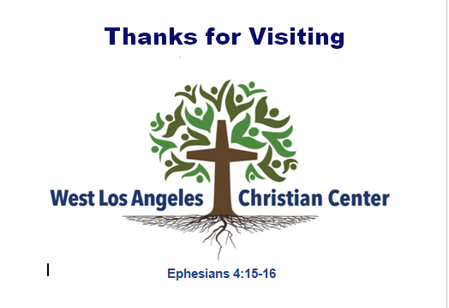
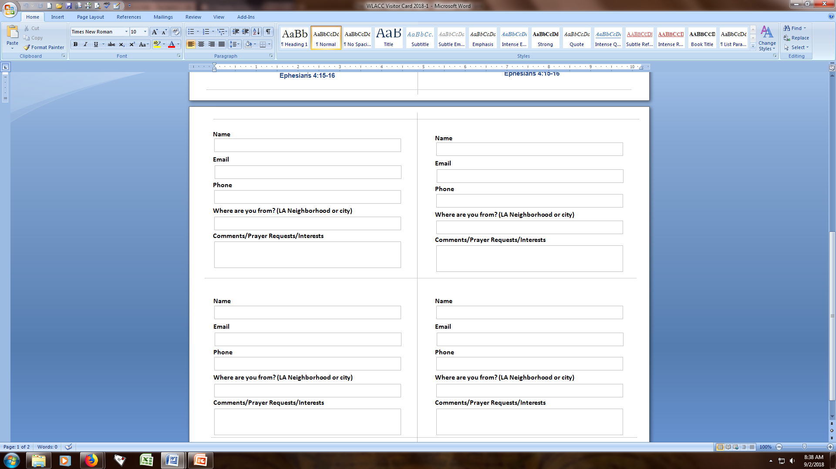
The Family of God
Making the connections with our adoptive family members:

Slide 12
