Slide 1
The Church That Jesus Would Build Today
BECOMING A CHURCH AS JESUS INTENDED

Slide 2
The Church that Jesus Would Build Today
If Jesus were to build a church today, what would that church be like?

Slide 3
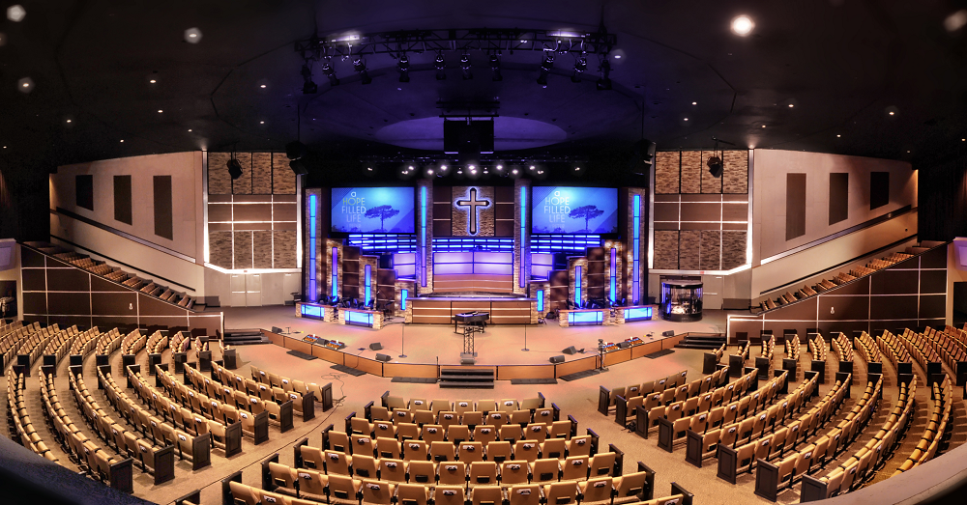
The Church that Jesus Would Build Today
?
?

Slide 4
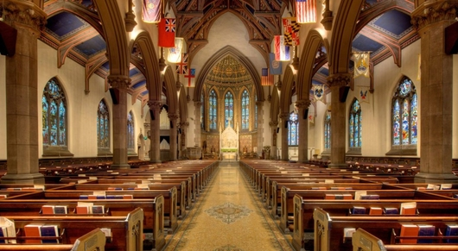

The Church that Jesus Would Build Today

Slide 5
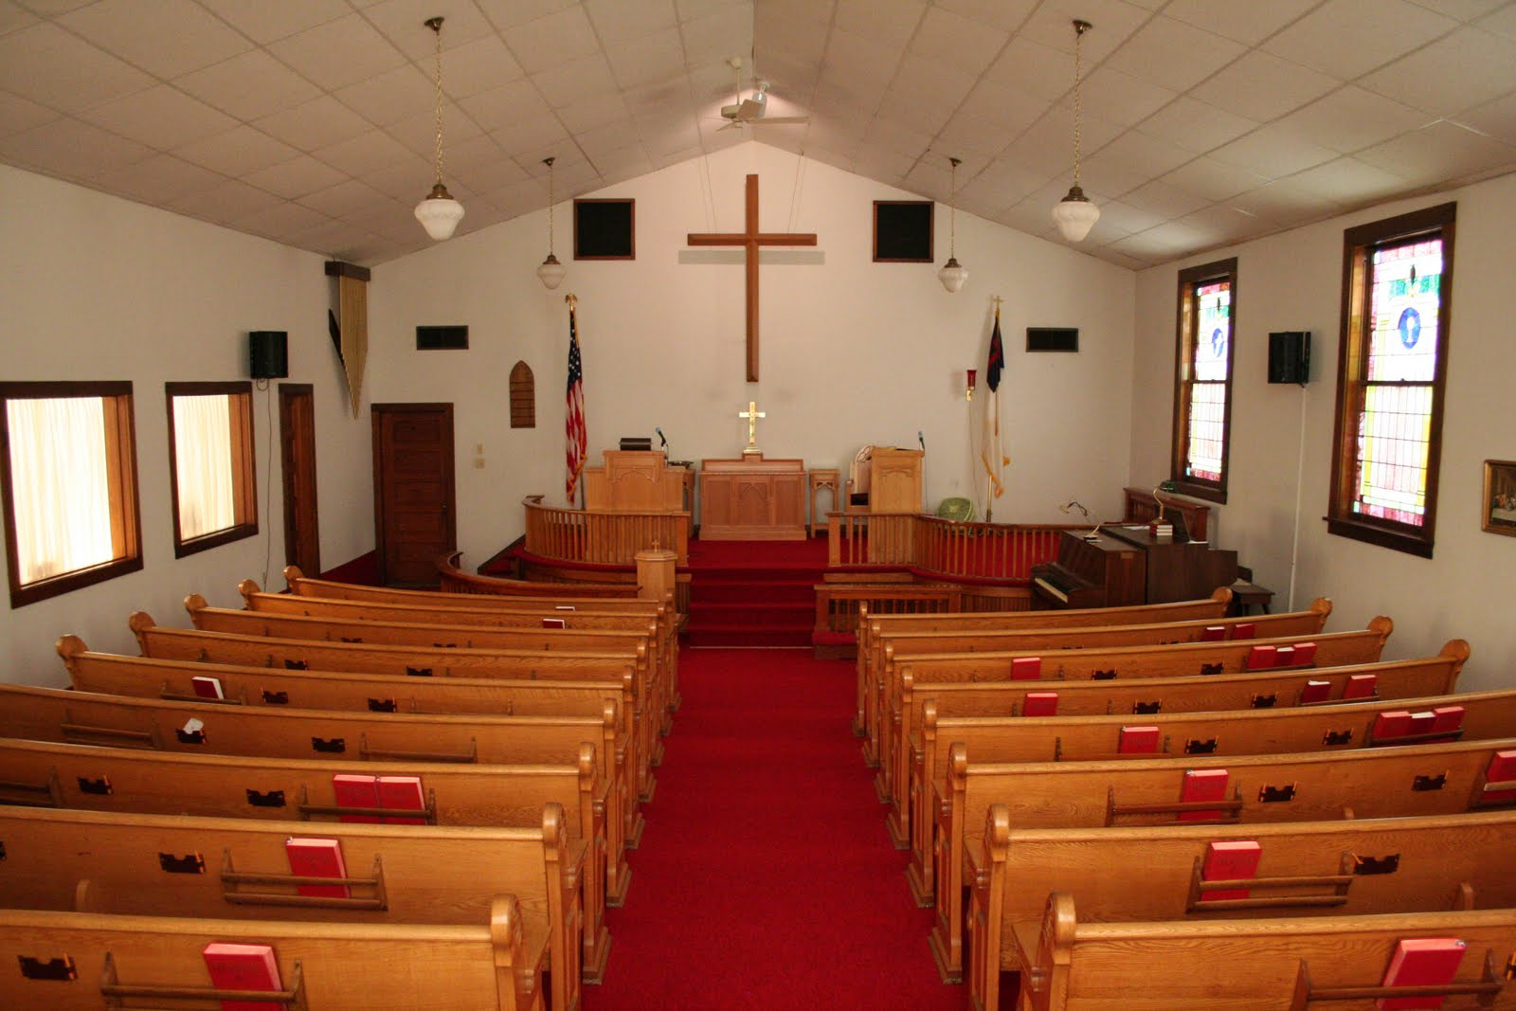

The Church that Jesus Would Build Today

Slide 6
The Church that Jesus Would Build Today

Slide 7
The Church that Jesus Would Build Today
Matthew 16:18
¹⁸ And I tell you that you are Peter, and on this rock I will build my church, and the gates of Hades will not overcome it.

Slide 8
The Church that Jesus Would Build Today
Church…
…is not a physical building
…Greek word ekklesia-
ek, "out from and to“ and
kaléō, "to call“
…is the assembly of all people who have been called out of the world by God

Slide 9
The Church that Jesus Would Build Today
Who have been called out?
1 Corinthians 1:2
To the church of God in Corinth, to those sanctified in Christ Jesus and called to be his holy people, together with all those everywhere who call on the name of our Lord Jesus Christ—their Lord and ours
Notes:
Sanctified-purified internally by reformation of soul
Called-"divinely called“-focuses on God's general call – i.e. the call (invitation) He gives to all people, so all can receive His salvation. God desires every person to call out to Him and receive His salvation

Slide 10
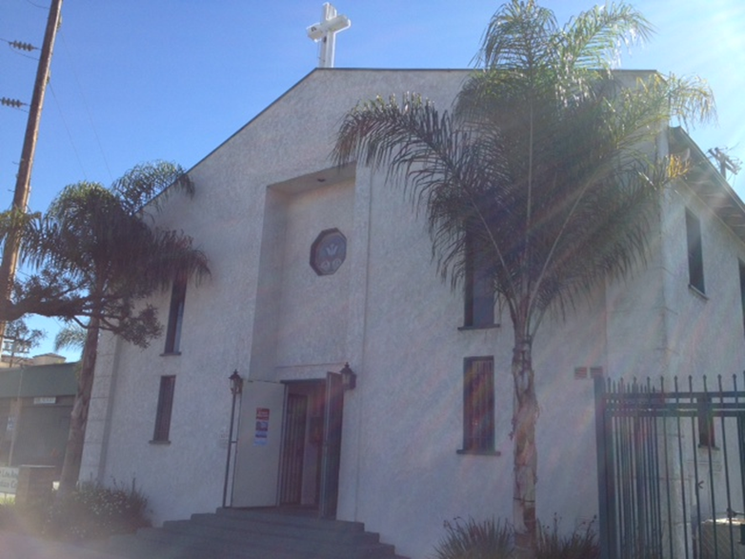
The Church that Jesus Would Build Today
Local Church vs. Universal Church
Local (i.e. church of God in Corinth)
A group of people who believe in Jesus Christ as Lord and Savior, who are committed to meeting regularly for worship, teaching, fellowship, prayer, encouragement, and admonishment (Acts. 2:42, Col. 3:16,)
A group of people who help make disciples of all people (Matthew 28:19-20)

Slide 11


The Church that Jesus Would Build Today
Local Church vs. Universal Church
Universal
All those everywhere (worldwide) who call on the name of our Lord Jesus Christ (from the Day of Pentecost until He returns).

Slide 12
The Church that Jesus Would Build Today
If Jesus were to build a church today, what would that church be like?

Slide 13
The Church that Jesus Would Build Today
The foundation would be at the cross
The emphasis would be on the vertical relationship with God
The evidence of one’s relationship with God would be the horizontal relationships with others
The growth would be based on transformed lives and not programs, activities, and amenities

Slide 14
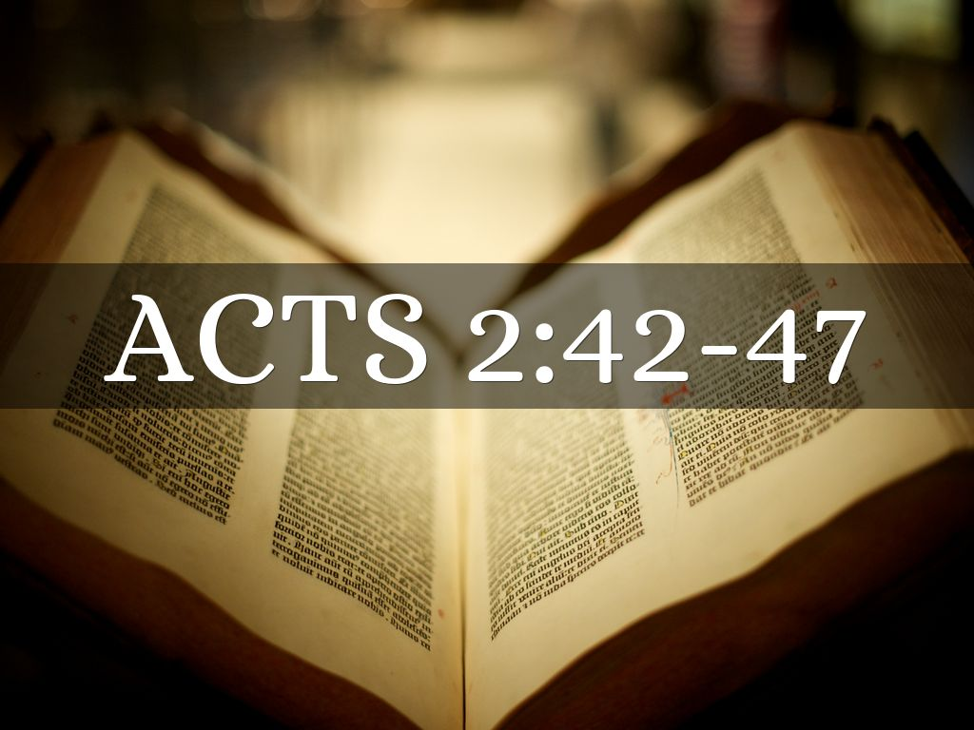
The Church that Jesus Would Build Today
Notes:
Devoted
to adhere to one, be his adherent, to be devoted or constant to one
to be steadfastly attentive unto, to give unremitting care to a thing
to continue all the time in a place
to persevere and not to faint
to show one's self courageous for
to be in constant readiness for one, wait on constantly
To give constant attention to a thing

