Slide 1


Slide 2



Slide 3
The Church That Jesus Would Build Today
BECOMING A CHURCH AS JESUS INTENDED

Slide 4
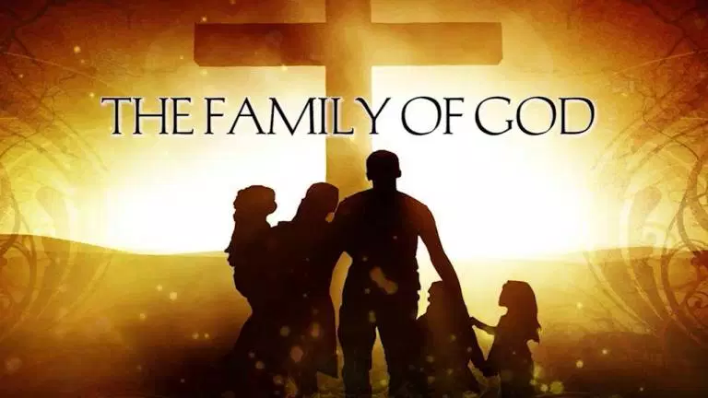

Slide 5
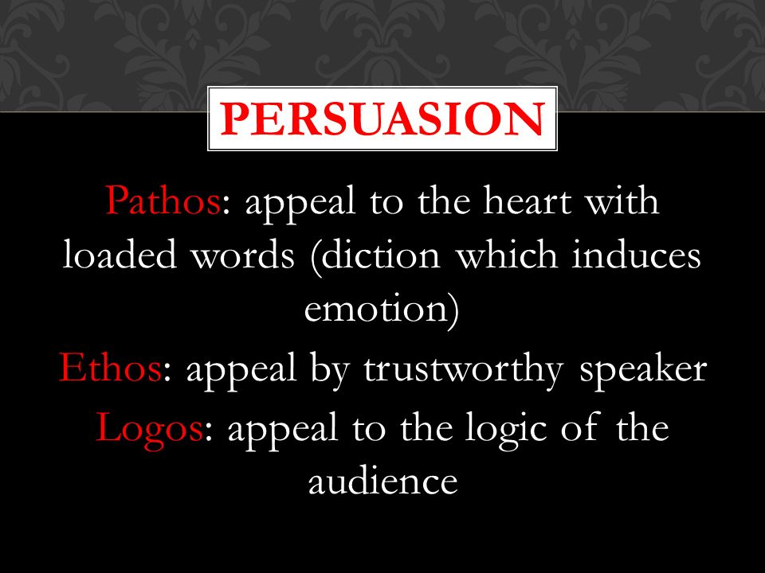

Slide 6
The Power to Overcome
Luke 10:1-24

Slide 7
The Power to Overcome
Luke 10:19
I have given you authority to trample on snakes and scorpions and to overcome all the power of the enemy; nothing will harm you.
Notes:
Given-
to furnish, endue, (one with a thing):
Authority-
force, capacity, competency, freedom, or (objectively) mastery (concretely, magistrate, superhuman, potentate, token of control), delegated influence:—authority, jurisdiction, liberty, power, right, strength.
Trample-
to trample, crush with the feet
to advance by setting foot upon, tread upon: to encounter successfully the greatest perils from the machinations and persecutions with which Satan would fain thwart the preaching of the gospel
to strike or sting with a single blow (like a scorpion)
Serpents-
with the ancients, the serpent was an emblem of cunning and wisdom. The serpent who deceived Eve was regarded by the Jews as the devil
Scorpions-
When a person has been stung by a scorpion, the part around the wound swells and becomes very painful, the hands and feet become cold, the skin is pale, and there is a feeling as though there were needles in every part of it. This pain often increases and rages until the person dies in great suffering.
Over all of the power of the enemy-
All-the whole, every kind of, each, every; each "part(s) of a totality"
Power-inherent power, power residing in a thing by virtue of its nature, or which a person or thing exerts and puts forth"
Enemy-describes a person resolved to inflict harm– i.e. driven by irreconcilable, deep-rooted enmity; the devil, the most bitter enemy of the divine government
Nothing-
a powerful negating conjunction. It rules out by definition, i.e. "shuts the door" objectively and leaves no exceptions; not + one thing
Will harm-
act unjustly towards, injure, harm; do wrong (commit injustice), especially to inflict undeserved hurt by ignoring God's justice – i.e. acting contrary to what is divinely approved.

Slide 8
The Power to Overcome
Luke 10:19 (AMPC)
Behold! I have given you authority and power to trample upon serpents and scorpions, and [physical and mental strength and ability] over all the power that the enemy [possesses]; and nothing shall in any way harm you.

Slide 9
The Power to Overcome
Acts 26:16-18
Notes:
Acts 26:16-18
'Now get up and stand on your feet. I have appeared to you to appoint you as a servant and as a witness of what you have seen and will see of me. I will rescue you from your own people and from the Gentiles. I am sending you to them to open their eyes and turn them from darkness to light, and from the power of Satan to God, so that they may receive forgiveness of sins and a place among those who are sanctified by faith in me.'

Slide 10
The Power to Overcome
Ezekiel 2:4-8
Notes:
Eze 2:4-8
The people to whom I am sending you are obstinate and stubborn. Say to them, 'This is what the Sovereign LORD says. And whether they listen or fail to listen--for they are a rebellious people--they will know that a prophet has been among them. And you, son of man, do not be afraid of them or their words. Do not be afraid, though briers and thorns are all around you and you live among scorpions. Do not be afraid of what they say or be terrified by them, though they are a rebellious people. You must speak my words to them, whether they listen or fail to listen, for they are rebellious. As for you, son of man, hear what I say to you; be not rebellious like that rebellious house; open your mouth and eat what I give you.

Slide 11
The Power to Overcome
Acts 1:4-5
Acts 1:7-8
Acts 2:41-43
Notes:
Acts 1:4-5
Wait for the gift of the Holy Spirit
Acts 1:7-8
You will receive power when the Holy Spirit comes on you
You will be my witnesses
Acts 2:41-43
Many believed, were baptized and added to their number
They devoted themselves to teaching, fellowship, breaking of bread and prayer
Everyone was excited and the apostles did many miracles
Believers were in one accord and shared with one another

