Slide 1

GODLY GIVING
GIVING WITH A CHEERFUL HEART

Slide 2
Godly Giving
What are the Biblical guidelines for giving?
Am I giving with the right motives?
Am I giving enough?
What are the benefits of giving?

Slide 3
Godly Giving
1 Chronicles 29:9 (NIV)
The people rejoiced at the willing response of their leaders, for they had given freely and wholeheartedly to the Lord. David the king also rejoiced greatly.

Slide 4
Godly Giving
1 Chronicles 29:17 (NIV)
I know, my God, that you test the heart and are pleased with integrity. All these things I have given willingly and with honest intent. And now I have seen with joy how willingly your people who are here have given to you.

Slide 5
Godly Giving
2 Cor. 9:6-8 (NIV)
⁶ Remember this: Whoever sows sparingly will also reap sparingly, and whoever sows generously will also reap generously. ⁷ Each of you should give what you have decided in your heart to give, not reluctantly or under compulsion, for God loves a cheerful giver. ⁸ And God is able to bless you abundantly, so that in all things at all times, having all that you need, you will abound in every good work.

Slide 6
Godly Giving
2 Cor. 9:9 (NIV)
⁹ As it is written:
“They have freely scattered their gifts to the poor; their righteousness endures forever.”
Notes:
From Ps. 112:9
Freely scattered-disperse, scatter abroad (as of sheep); dissipate, waste; distribute alms
-To scatter abroad (what others may collect for themselves), of one dispensing blessings liberally
Righteousness-what is approved by God

Slide 7
Godly Giving
2 Cor. 9:10-11 (NIV)
¹⁰ Now he who supplies seed to the sower and bread for food will also supply and increase your store of seed and will enlarge the harvest of your righteousness. ¹¹ You will be enriched in every way so that you can be generous on every occasion, and through us your generosity will result in thanksgiving to God.

Slide 8
Godly Giving
Motivations for Giving
Guilt vs. Responsibility
Getting vs. Reaping
Paying God vs. Thanking God
Notes:
Guilt vs. Responsibility-Luke 12:48
Getting vs. Reaping-2 Cor. 9:6-8, 11

Slide 9
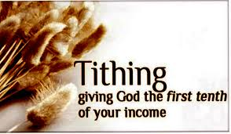
Godly Giving
Notes:
Mal 3:8-12

Slide 10

Godly Giving
Notes:
Offering
-Given from our abundance
-As the Lord provides and guides

Slide 11
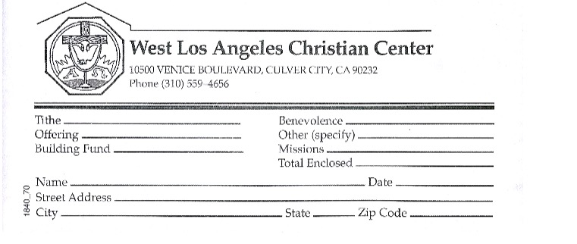
Godly Giving
Notes:
Offering
-Given from our abundance
-As the Lord provides and guides

Slide 12
Godly Giving
Guidelines for Giving
Should be regular and consistent
Should be planned
Should be proportionate
Should be sacrificial and generous

Slide 13
Godly Giving
2 Cor. 9:12-15 (NIV)
¹⁵ Thanks be to God for his indescribable gift!

