Slide 1
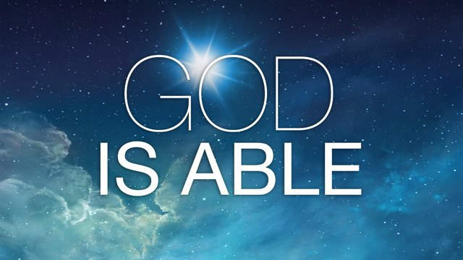

Slide 2
God is Able
Ephesians 3:20-21
²⁰ Now to him who is able to do immeasurably more than all we ask or imagine, according to his power that is at work within us, ²¹ to him be glory in the church and in Christ Jesus throughout all generations, for ever and ever! Amen.

Slide 3
God is Able
Paul’s Prayers (Ephesians 3:16-19)
-That He may strengthen you with power through His Spirit in your inner being
-That Christ may dwell in your hearts through faith
-That you may have the power to grasp how wide and long and high and deep is the love of Christ

Slide 4
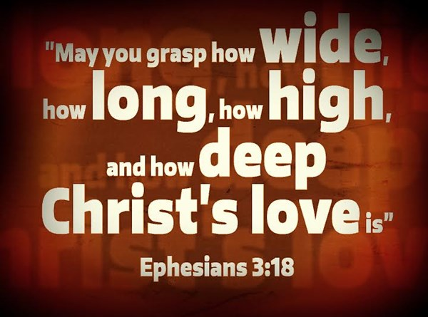
God is Able

Slide 5
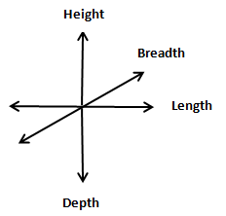
God is Able
(Width)

Slide 6
God is Able
Paul’s Prayers (Ephesians 3:16-19)
-For you to know this love that surpasses knowledge
-that you may be filled to the measure of all the fullness of God

Slide 7
God is Able
To him who is able (gk. dynamai)
To be able
To have power
To be capable, strong, and powerful
Notes:
Dynamai-dynamite, dynamo
By virtue of one’s own ability and resources
Of a state of mind
Through favorable circumstances
By permission

Slide 8
God is Able
To do
-make, manufacture, construct
-carry out, execute
-to perform: to a promise

Slide 9
God is Able
Immeasurably
Far more abundantly beyond (NASB)
superabundantly; beyond measure; exceedingly
+
over, beyond, more than
Notes:
Hyperekperissou + hyper

Slide 10
God is Able
Than all we ask
Than all we imagine
Notes:
Ask-
the petition of one who is lesser in position than he to whom the petition is made
man asking God
Imagine
perceive with the mind, understand, have understanding
think upon, heed, ponder, consider

Slide 11
God is Able
At work within us
-to put forth power, be operative, to work

Slide 12
God is Able
To Him be the glory
in the church
in Christ Jesus
Notes:
Be the glory-
good opinion, praise, honor, glory, an appearance commanding respect, magnificence, excellence, manifestation of glory

Slide 13
God is Able
Throughout all generations
For ever and ever!
Notes:
Generation
age, generation, nation, time.

Slide 14
God is Able
Amen
so it is, so be it, may it be fulfilled
made the substance of what was uttered their own
Notes:
Amen
A universal word. It has been called the best known word in human speech.
The Hebrew word for "believe" (amam), or faithful
It came to mean "sure" or "truly", an expression of absolute trust and confidence.

Slide 15
God is Able
Ephesians 3:20 (MSG)
God can do anything, you know—far more than you could ever imagine or guess or request in your wildest dreams! He does it not by pushing us around but by working within us, his Spirit deeply and gently within us.

Slide 16
God is Able
Ephesians 3:21 (MSG)
Glory to God in the church! Glory to God in the Messiah, in Jesus! Glory down all the generations! Glory through all millennia! Oh, yes!

Slide 17

God is Able
http://www.youtube.com/watch?v=AjZMUvn21QU
℗ 2016 South West Christian Church

