Slide 1
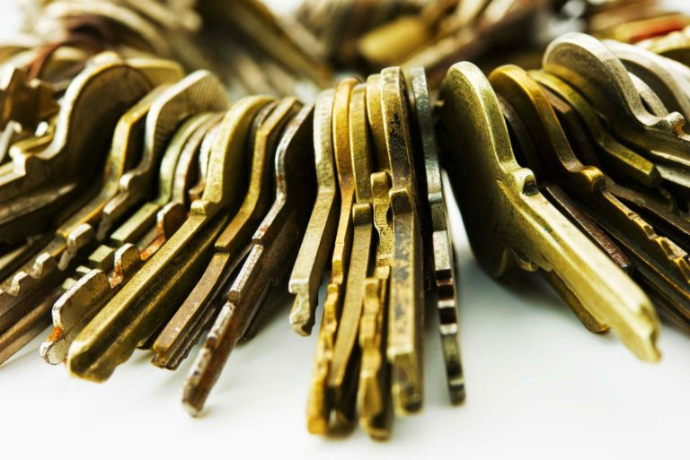
Keys to KINGDOM OF Heaven
Power and authority on Earth

Slide 2
Keys to Kingdom of Heaven
“There’s nothing that I can do about it”
“It is what it is”
“What does it matter, anyways?”
“Life (____________) happens”
“God helps those who help themselves”
“Don’t worry”
“Everything is going to be alright”

Slide 3
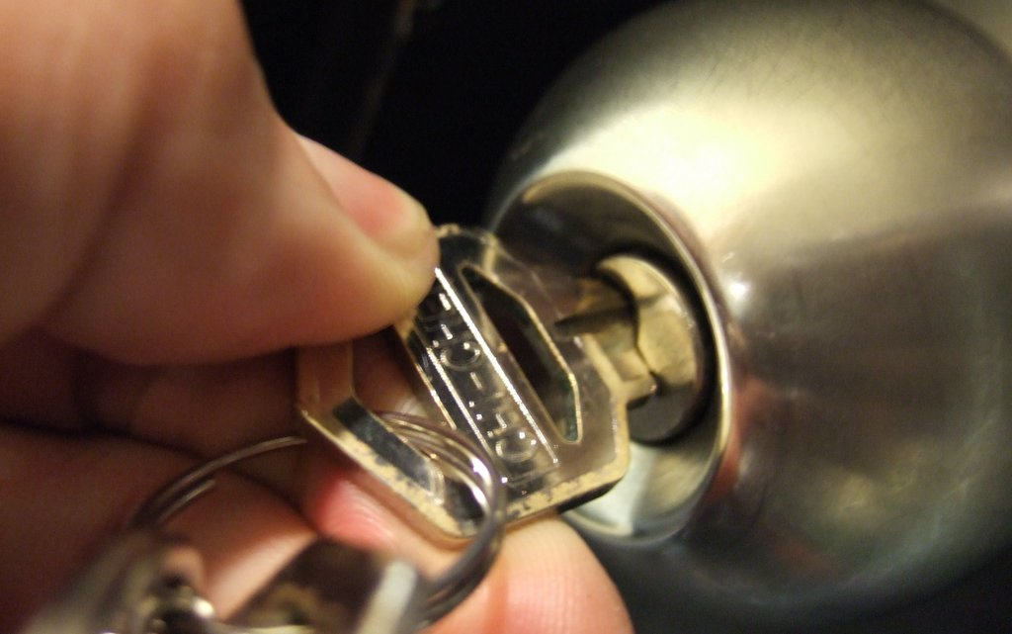
Keys to the Kingdom of Heaven

Slide 4
Keys to the Kingdom of Heaven
Matthew 16:19
I will give you the keys of the kingdom of heaven; whatever you bind on earth will be bound in heaven, and whatever you loose on earth will be loosed in heaven.”

Slide 5
Keys to the Kingdom of Heaven
“I will give…”
Notes:
Giving something to someone…a gift, permission, care of someone or something, someone as your own.

Slide 6
Keys to the Kingdom of Heaven
“the keys”
Notes:
Keys give keeper the authority and power to open and shut.
Denotes power and authority of various kinds.

Slide 7
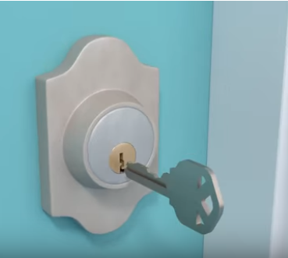
Keys to the Kingdom of Heaven
How a Pin Tumbler Lock Works
Notes:
Each key uniquely fits into the lock that it was made for
Any pin (even one) slightly out of alignment will prevent the key from opening or closing the lock

Slide 8
Keys to the Kingdom of Heaven
“kingdom of heaven”
Notes:
Kingdom-royal power, kingship, dominion, rule
-the right or authority to rule over a kingdom of the royal power of Jesus as the triumphant Messiah
Heaven-the vaulted expanse of the sky with all things visible in it
the universe, the world
the aerial heavens or sky
the sidereal or starry heavens
the seat of order of things eternal and consummately perfect where God dwells and other heavenly beings

Slide 9
Keys to the Kingdom of Heaven
“whatever you bind”
Notes:
Whatever (whoever, whichever) you forbid, prohibit, declare to be illicit or unlawful

Slide 10
Keys to the Kingdom of Heaven
“will be bound in heaven”
Notes:
Present indicative-in order to talk about events and actions occurring right now
What is happening, what happened, what will happen
Gives the facts
“shall remain bound”
“shall continue to be bound”

Slide 11
Keys to the Kingdom of Heaven
“whatever you loose”
Notes:
Whatever (whoever, whichever) you loose (unleash) let go; release (unbind) so something no longer holds together; release what has been held back

Slide 12
Keys to the Kingdom of Heaven
“will be loosed in heaven”
Notes:
Present indicative-in order to talk about events and actions occurring right now
What is happening, what happened, what will happen
Gives the facts
“shall remain losed”
“shall continue to be loosed”

Slide 13
Keys to the Kingdom of Heaven
Matthew 16:19 Amplified Bible
I will give you the keys (authority) of the kingdom of heaven; and whatever you bind [forbid, declare to be improper and unlawful] on earth will have [already] been bound in heaven, and whatever you loose [permit, declare lawful] on earth will have [already] been loosed in heaven.

Slide 14
Keys to the Kingdom of Heaven
Matthew 18:19
“Again, truly I tell you that if two of you on earth agree about anything they ask for, it will be done for them by my Father in heaven.

Slide 15
Keys to the Kingdom of Heaven
“agree”
Notes:
Agree-Gk. Symphoneo
To be in accord such as a music chord
To harmonize
To agree together

Slide 16
Keys to the Kingdom of Heaven
“about anything you ask for”
Notes:
Concerning all, the whole, every kind of matter or deed

Slide 17
Keys to the Kingdom of Heaven
“it will be done”
Notes:
to emerge, become, transitioning from one point (realm, condition) to another.
to change from condition, state, or place
God’s actions as emerging from eternity and becoming (showing themselves) in time (physical space)

Slide 18
Keys to the Kingdom of Heaven
Matthew 18:19 AMP
“Again I say to you, that if two believers on earth agree [that is, are of one mind, in harmony] about anything that they ask [within the will of God], it will be done for them by My Father in heaven.

Slide 19
Keys to KINGDOM OF Heaven
Power and authority on Earth

