Slide 1

Be Careful in What You Say or Do
Because Someone is Always Watching You

Slide 2
Be Careful in What You Say or Do
“I tell it like it is (or how I see it)”
“Do what I say and not what I do”
“If people don’t like how I am, then tough—they don’t have to hang out with me”
“Get it off of your chest, you will feel better”
“What I do when no one is watching me is my business and nobody else’s”
Notes:
As we grow as a church, we will be dealing more with people that who are strangers rather than people who we know. What will they see in us?

Slide 3
Be Careful in What You Say or Do
Matthew 23
Teachers of the Law
a scribe, one learned in the Jewish Law, a religious teacher, the town-clerk, the secretary of the city, a man of learning
Pharisees
a separatist, a purist, someone "separated from sin."
Notes:
Prior to this passage, Jesus talked to the people about the parable of the wedding banquet, paying taxes to Caesar, marriage at the resurrection, the greatest commandment, and the Messiah.
Most of these topics were in response to the religious people trying to trick Jesus.

Slide 4
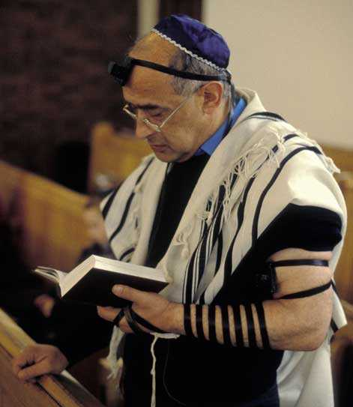
Be Careful in What You Say or Do
Matthew 23

Slide 5
Be Careful in What You Say or Do
Matthew 23:13, 15, 23, 25, 27, 29
Hypocrite
A hypocrite is an actor/stage-player in religion
A performer acting under a mask (i.e. a theater-actor);
A two-faced person
One whose profession does not match their practice – i.e. someone who "says one thing but does another."

Slide 6
Be Careful in What You Say or Do
Matthew 23:13-32
Wo to You Hypocrites
You clean up what is on the outside but inside is greed and self-indulgence (v. 25-26)
You make the outside appear beautiful and righteous but inside are full of wickedness and hypocrisy (v. 27-28)

Slide 7
Be Careful in What You Say or Do
Luke 6:45
⁴⁵ A good man brings good things out of the good stored up in his heart, and an evil man brings evil things out of the evil stored up in his heart. For the mouth speaks what the heart is full of.

Slide 8
Be Careful in What You Say or Do
Psalm 139:23-24
²³ Search me, God, and know my heart; test me and know my anxious thoughts.
²⁴ See if there is any offensive way in me, and lead me in the way everlasting.

Slide 9
Be Careful in What You Say or Do
Psalm 19:14
May these words of my mouth and this meditation of my heart be pleasing in your sight, LORD, my Rock and my Redeemer.

