Slide 1
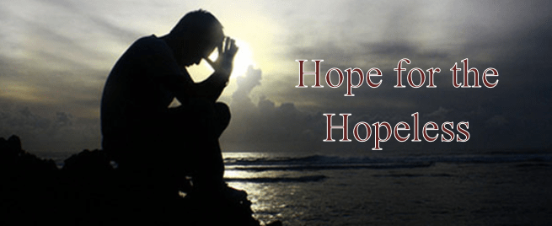

Slide 2
Hope for the Hopeless
Frustrated
Discouraged
Heartsick
Anxious
Stressed
Angry
?

Slide 3
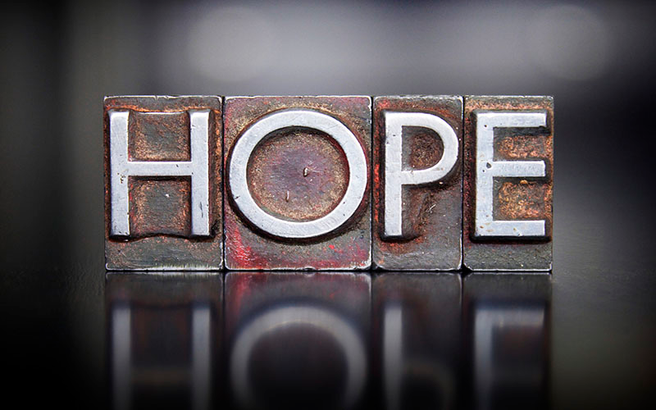

Slide 4
Hope for the Hopeless
Psalm 107
A psalm of despair and hope

Slide 5
Hope for the Hopeless
Psalm 107
v. 4-Some wandered in desert wastelands
v. 10-Some sat in darkness and deepest gloom
v. 17-Some became fools through their rebellious ways
v. 23-Others went out on the sea in ships

Slide 6
Hope for the Hopeless
Psalm 107
v. 6, 13, 19, 28
They cried out to the Lord in their trouble,
and He delivered them from their distress

Slide 7
Hope for the Hopeless
Psalm 107
v. 7-He led them by a straight way
v. 14-He brought them out of darkness and broke
away their chains
v. 20-He sent forth His word and healed them; He
rescued them from the grave
v. 29-He stilled the storm to a whisper; He guided
them to their desired haven.

Slide 8
Hope for the Hopeless
Psalm 107
v. 8, 15, 21, 31
Let them give thanks to the Lord for His unfailing love and His wonderful deeds for men

Slide 9
Hope for the Hopeless
Romans 8:26
The Spirit helps us in our weakness
Jointly helps-supplying help that exactly corresponds to the need.
Notes:
To lend a hand along with, take interest in (a thing) along with (others), assist jointly to perform some task, cooperate with, take my share in, help, aid.

Slide 10
Hope for the Hopeless
Romans 8:26
The Spirit Himself intercedes for us with groans that words cannot express.
Intercedes-the Holy Spirit intercedes (makes petition for, confers benefit) in every scene of our lives so we can "come in line with" the Lord's eternal purpose.

Slide 11
Hope for the Hopeless
Romans 8:27
The Spirit intercedes for the saints in accordance with God’s will.
Intercedes-to go and meet a person to converse, consult, to intervene ("intersect with")
"to strike, hit the bulls-eye" ("spot on").
Accordingly, antonym of "to miss the mark, sin"

Slide 12
Hope for the Hopeless
Romans 8:28-30
In all things, God works for the good of those who love Him, who have been called
We are predestined to be like Jesus
We are called
We are justified
We are glorified
Notes:
Predestined-to predetermine, decide beforehand
Called-invited
Justified-made right; free of all guilt and charges
Glorified-to ascribe weight by recognizing real substance (value)

Slide 13


