Slide 1
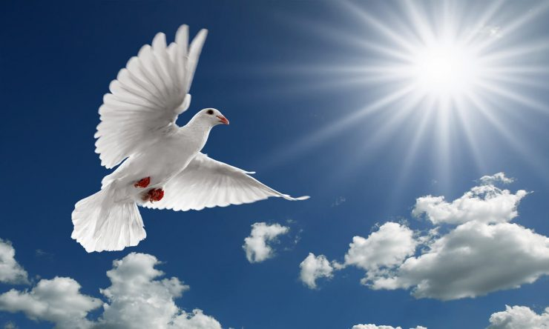
Pentecost Sunday
Celebrating the Gift of the Holy Spirit

Slide 2
Pentecost Sunday
Pentecost (gk. pentekoste)-fiftieth; fifty days after Easter
Fulfillment of Jesus’ promise to send the “Counselor” and “Spirit of Truth” (John 16:5-15)
Recorded in Acts 2:1-13
Occurred 10 days after the Ascension of Jesus
Known as “the birthday of the church”
Large scale spreading of Gospel took place—about 3000 saved and baptized (Acts 2:41)

Slide 3
Pentecost Sunday
God’s way of declaring that the Gospel is for all peoples, cultures, and languages
Holy Spirit came much more powerfully upon Jesus’ disciples, and now dwells in and empowers all disciples of Jesus today (Eph. 1:13-14)

Slide 4
Pentecost Sunday
Ephesians 1:13-14
¹³ And you also were included in Christ when you heard the message of truth, the gospel of your salvation. When you believed, you were marked in him with a seal, the promised Holy Spirit, ¹⁴ who is a deposit guaranteeing our inheritance until the redemption of those who are God’s possession—to the praise of his glory.
Notes:
(Gk. Arrabón)-an earnest, earnest-money, a large part of the payment, given in advance as a security that the whole will be paid afterwards.

Slide 5
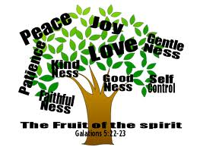
Pentecost Sunday
Fruits of the Spirit

Slide 6
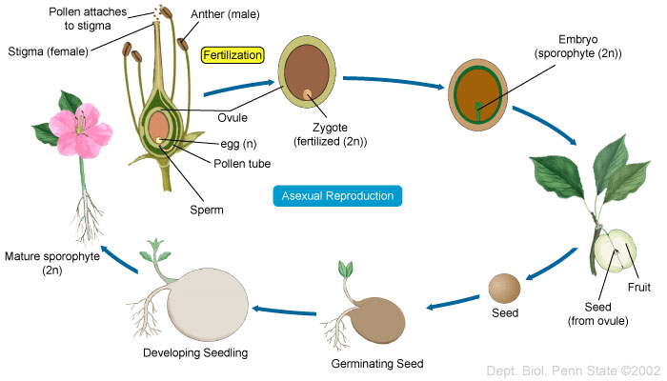
Pentecost Sunday
Development of Fruit
Notes:
Pollination-pollen lands near female part of flower producing pollen tube and sperm; sperm travel down growing pollen tube to reach egg

Slide 7
Pentecost Sunday
Fruits of the Spirit
Fruits of the Spirit

