Slide 1


Slide 2
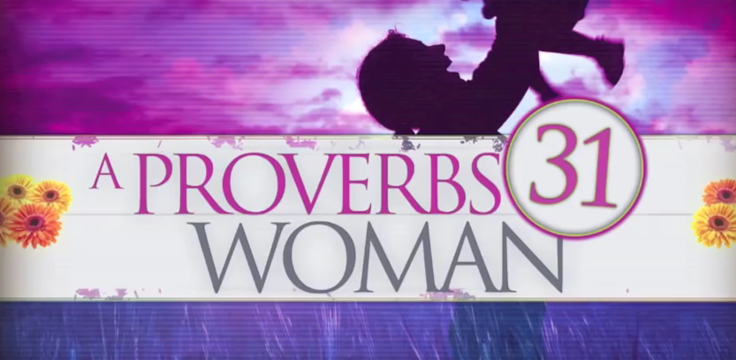
Happy Mother’s Day
A Proverbs 31 Woman

Slide 3
Happy Mother’s Day
Timothy’s Mothers in Sincere Faith
2 Timothy 1:3-5

Slide 4
Happy Mother’s Day
Timothy’s Mothers in Sincere Faith
2 Timothy 1:5
⁵ I am reminded of your sincere faith, which first lived in your grandmother Lois and in your mother Eunice and, I am persuaded, now lives in you also.

Slide 5
Happy Mother’s Day
Timothy’s Mothers in Sincere Faith
2 Timothy 1:5
sincere (gk. anupokritos)
- without hypocrisy
- unfeigned
- sincere
- not a phony
- sincere behavior free from hidden agendas (selfish motives)

Slide 6
Happy Mother’s Day
Timothy’s Mothers in Sincere Faith
2 Timothy 1:5
faith (gk. pistis)
- faith
-belief
-trust
-confidence
-fidelity
-faithfulness
Pistis is always a gift from God, and never something that can be produced by people
-God’s guarantee that everything He promised will come to pass

Slide 7
Happy Mother’s Day
Timothy’s Mothers in Sincere Faith
Acts 16:1-3
-Mother was a Jewish believer
-But father was a non-believing Greek

Slide 8
Happy Mother’s Day
Timothy’s Mothers in Sincere Faith
2 Timothy 3:14-17
Mothers leave a legacy to their children of:
-Knowledge
-Conviction
-Wisdom
-Teaching
-Correction
-Training
So that their children may be thoroughly equipped for every good work

