Slide 1
Come Grow With Us

Slide 2
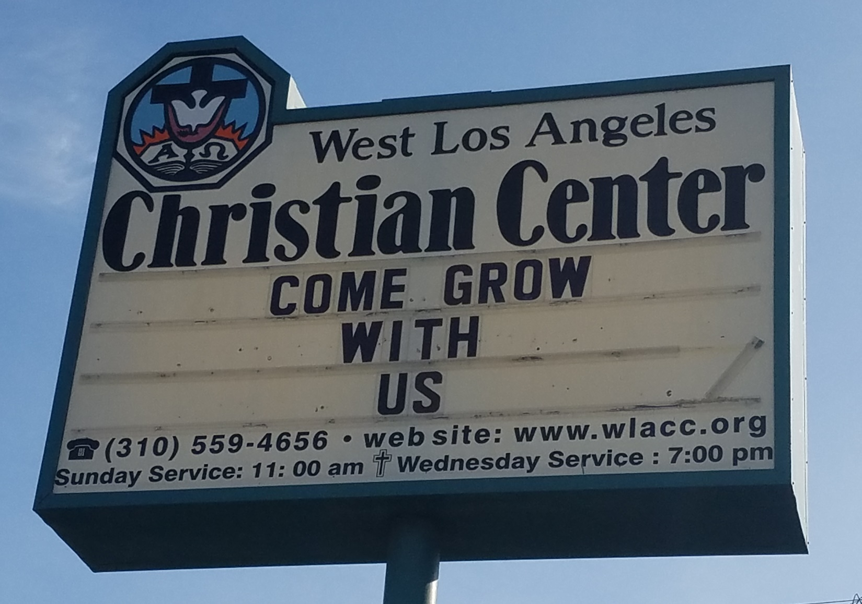
Come Grow With Us

Slide 3
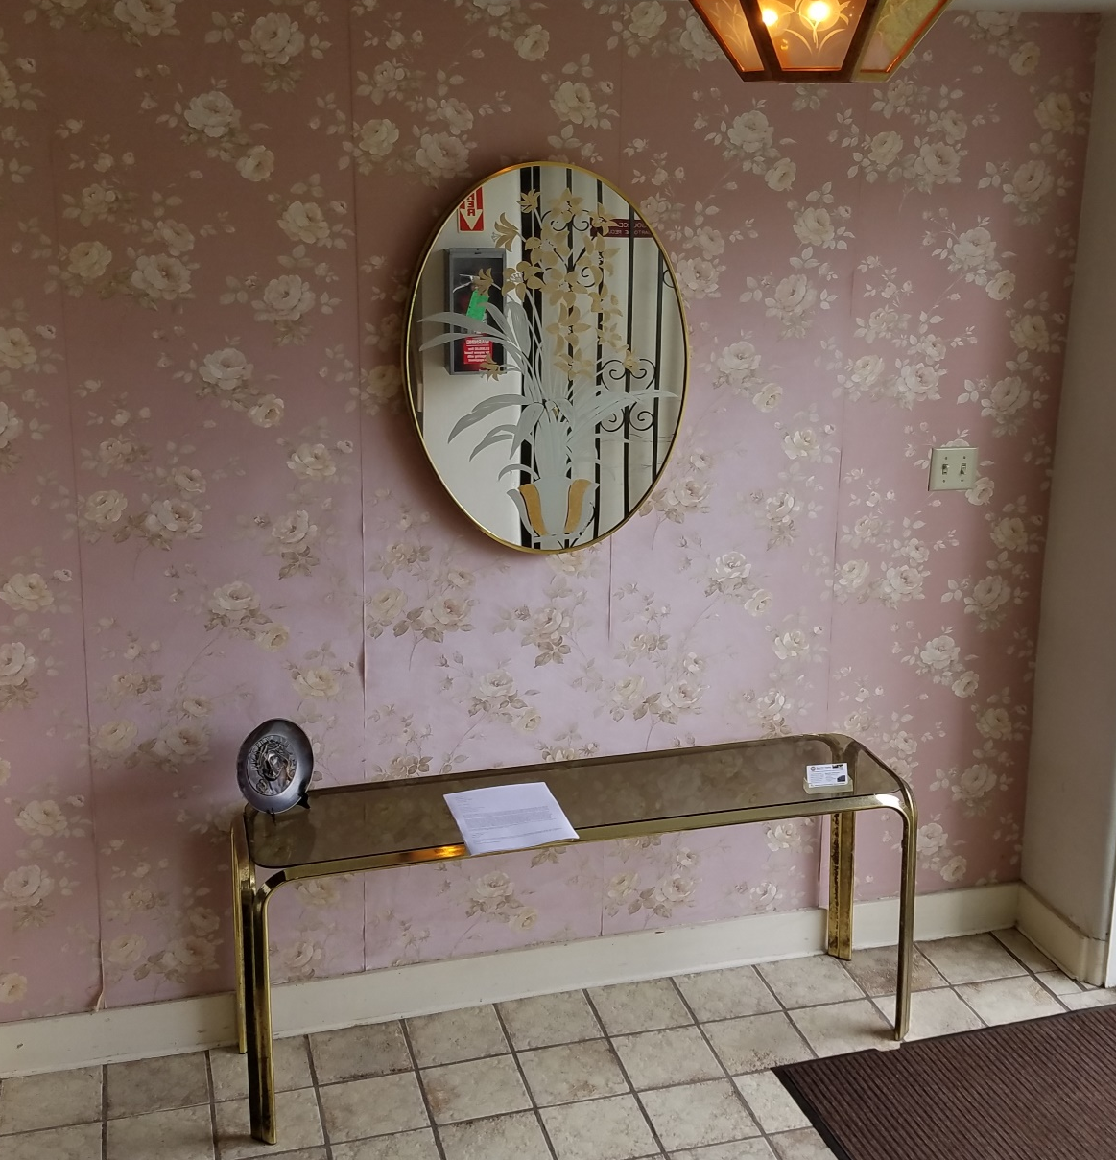
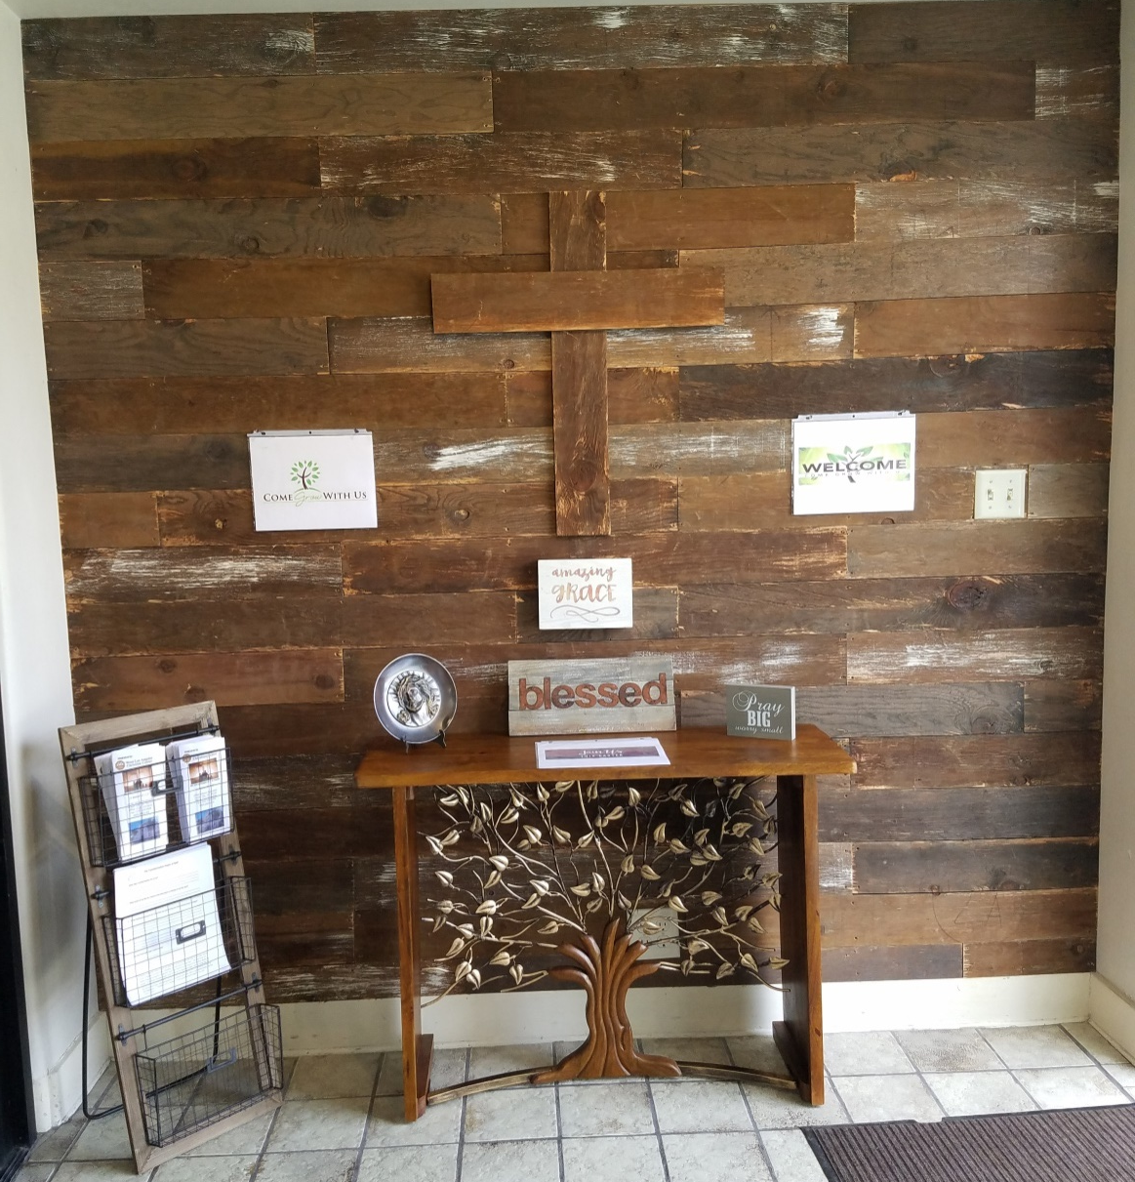
Come Grow With Us

Slide 4

Come Grow With Us

Slide 5
Come Grow With Us
Ephesians 4:15
¹⁵ Instead, speaking the truth in love, we will grow to become in every respect the mature body of him who is the head, that is, Christ.

Slide 6
Come Grow With Us
Ephesians 4:16
¹⁶ From him the whole body, joined and held together by every supporting ligament, grows and builds itself up in love, as each part does its work.

Slide 7
Come Grow With Us
Ephesians 4:15
Grow
-to cause to increase
-to become greater
-to become greater in size (maturity, etc.)

Slide 8
Come Grow With Us
We will encourage each other to find, pursue, and fulfill our God-given callings in our life (individual growth).
We will encourage others, who are currently not part of the church, to come witness and take an active part in the growth of our church (corporate growth)

Slide 9


