Slide 1
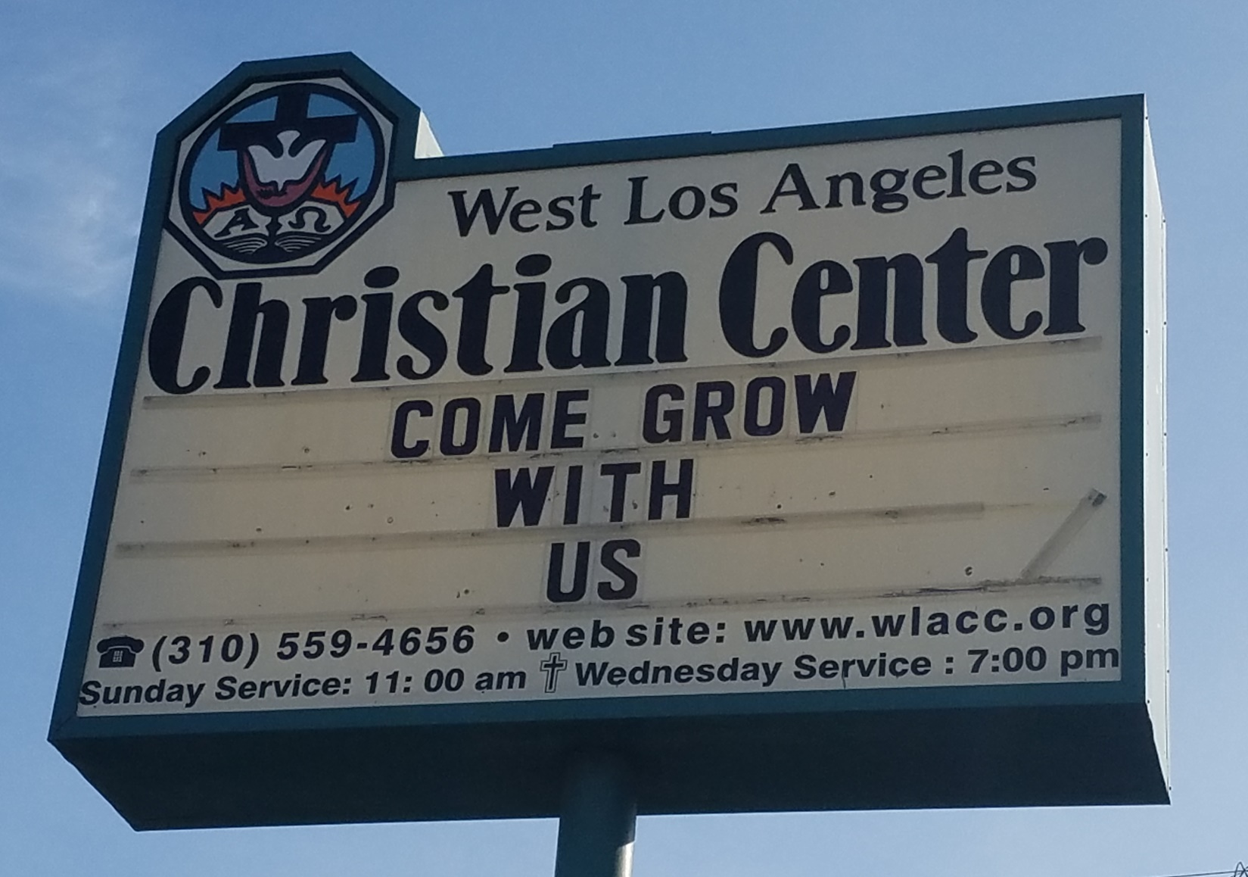
Come Grow With Us

Slide 2
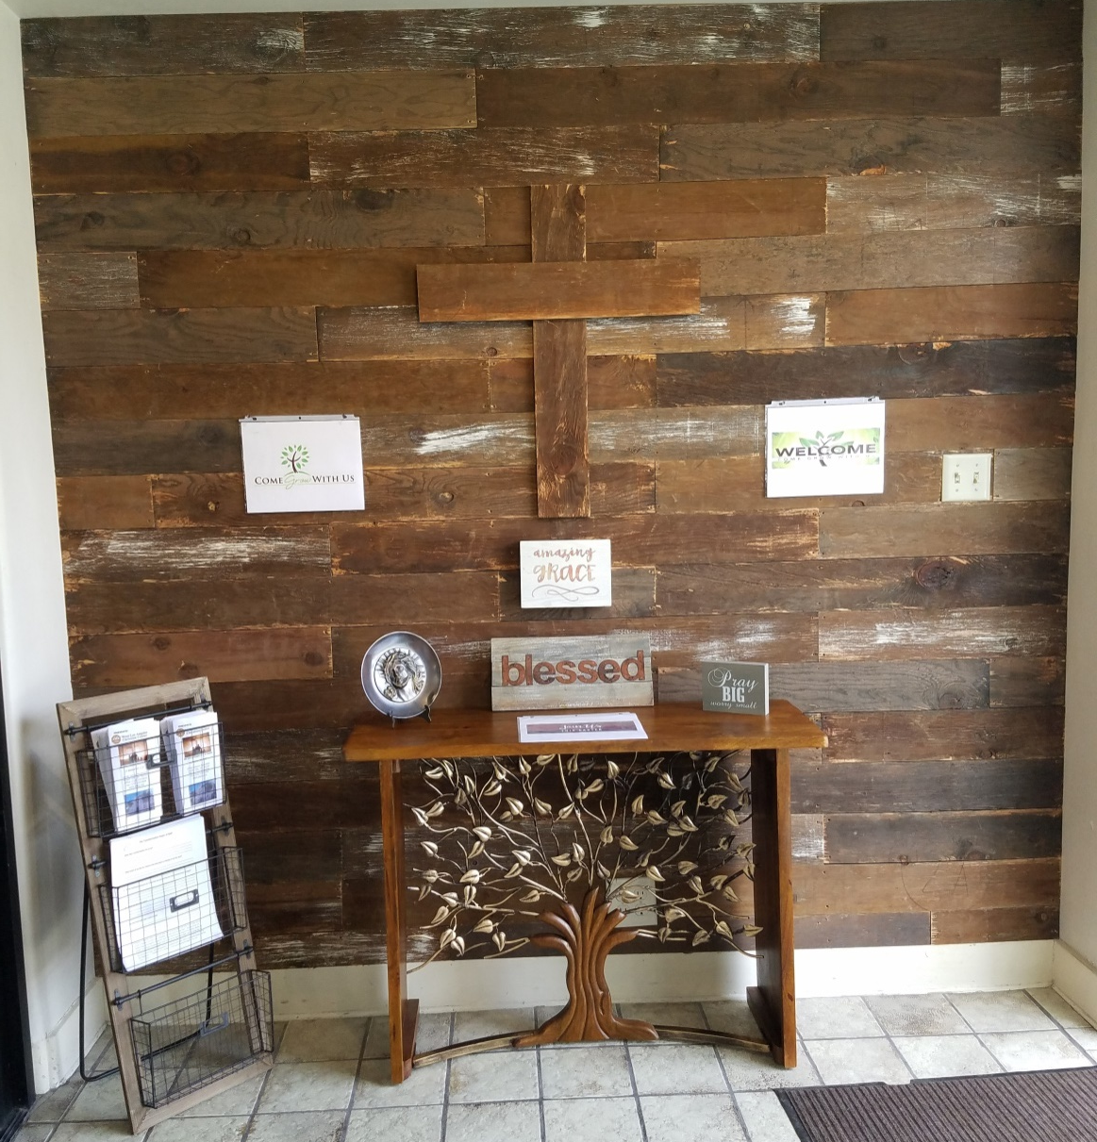
Come Grow With Us

Slide 3
Come Grow With Us
Ephesians 4:15
¹⁵ Instead, speaking the truth in love, we will grow to become in every respect the mature body of him who is the head, that is, Christ.

Slide 4
Come Grow With Us
Ephesians 4:16
¹⁶ From him the whole body, joined and held together by every supporting ligament, grows and builds itself up in love, as each part does its work.

Slide 5
Come Grow With Us
Ephesians 4:15
Grow
-to cause to increase
-to become greater
-to become greater in size (maturity, etc.)

Slide 6
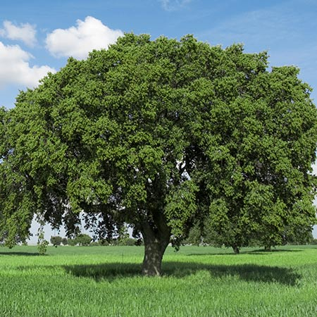
Come Grow With Us

Slide 7
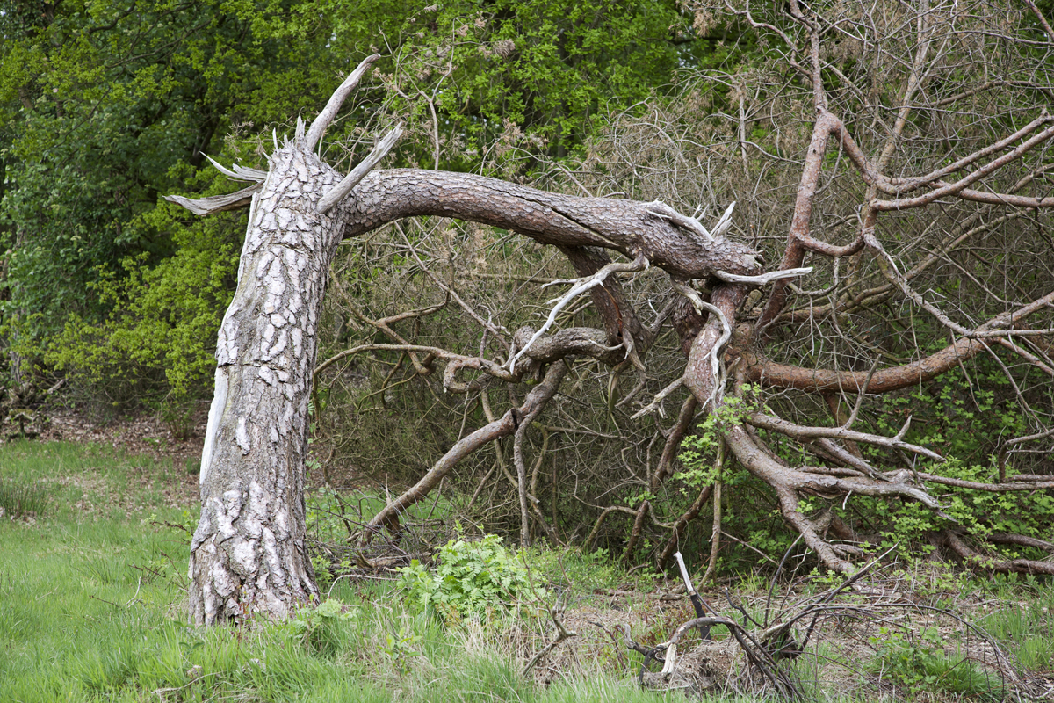
Come Grow With Us

Slide 8
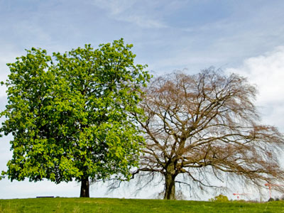
Come Grow With Us

Slide 9
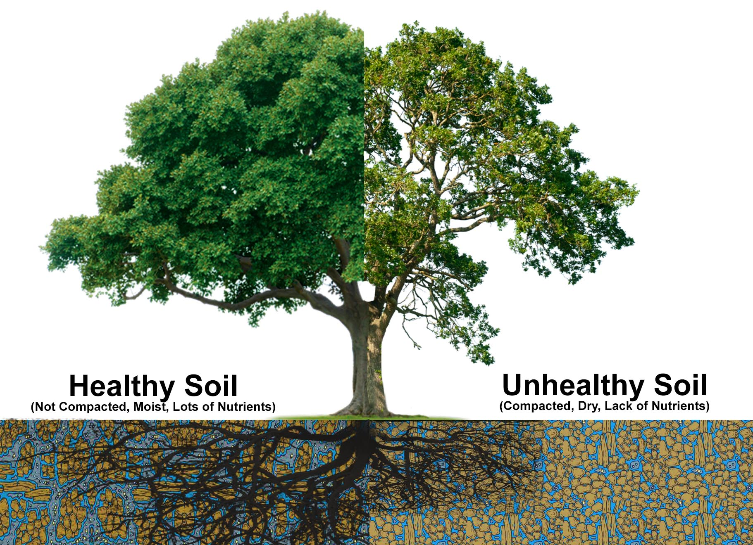
Come Grow With Us

Slide 10
Come Grow With Us
John 15:1-4
¹“I am the true vine, and my Father is the gardener. ² He cuts off every branch in me that bears no fruit, while every branch that does bear fruit he prunes so that it will be even more fruitful. ³ You are already clean because of the word I have spoken to you. ⁴ Remain in me, as I also remain in you. No branch can bear fruit by itself; it must remain in the vine. Neither can you bear fruit unless you remain in me.

Slide 11
Come Grow With Us
John 15:5-8
⁵ “I am the vine; you are the branches. If you remain in me and I in you, you will bear much fruit; apart from me you can do nothing. ⁶ If you do not remain in me, you are like a branch that is thrown away and withers; such branches are picked up, thrown into the fire and burned. ⁷ If you remain in me and my words remain in you, ask whatever you wish, and it will be done for you. ⁸ This is to my Father’s glory, that you bear much fruit, showing yourselves to be my disciples.

Slide 12
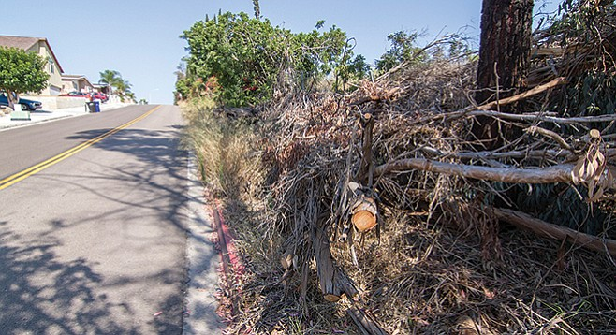
Come Grow With Us

Slide 13
Come Grow With Us
Isaiah 11:11
¹¹ In that day the Lord will reach out his hand a second time to reclaim the surviving remnant of his people from Assyria, from Lower Egypt, from Upper Egypt, from Cush,[a] from Elam, from Babylonia,[b] from Hamath and from the islands of the Mediterranean.

Slide 14
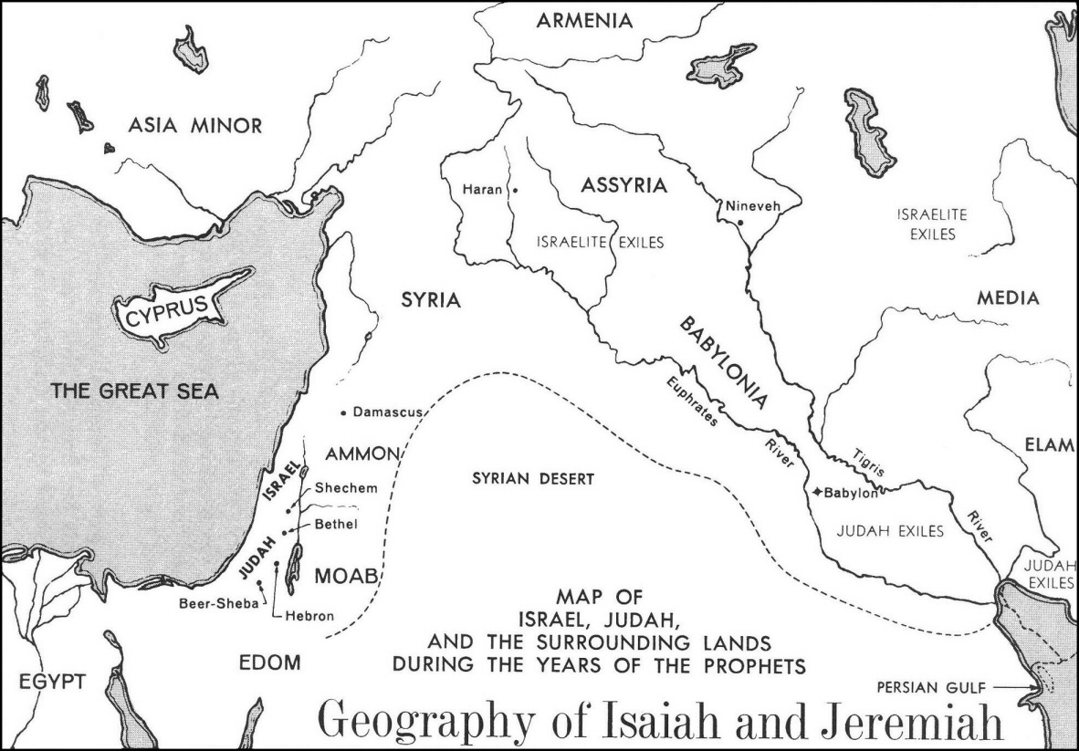
Come Grow With Us

Slide 15
Come Grow With Us

Slide 16
Come Grow With Us
Isaiah 11:11
Reclaim (gk.-qanah)
-to get
-to acquire
-to redeem
-to bring back
-to recover
-to reach out
-to possess

Slide 17
Come Grow With Us
Isaiah 11:11
Redeem
1. to compensate for the faults or bad aspects of (something).
2. to gain or regain possession of (something) in exchange for payment.

Slide 18
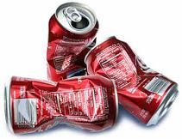
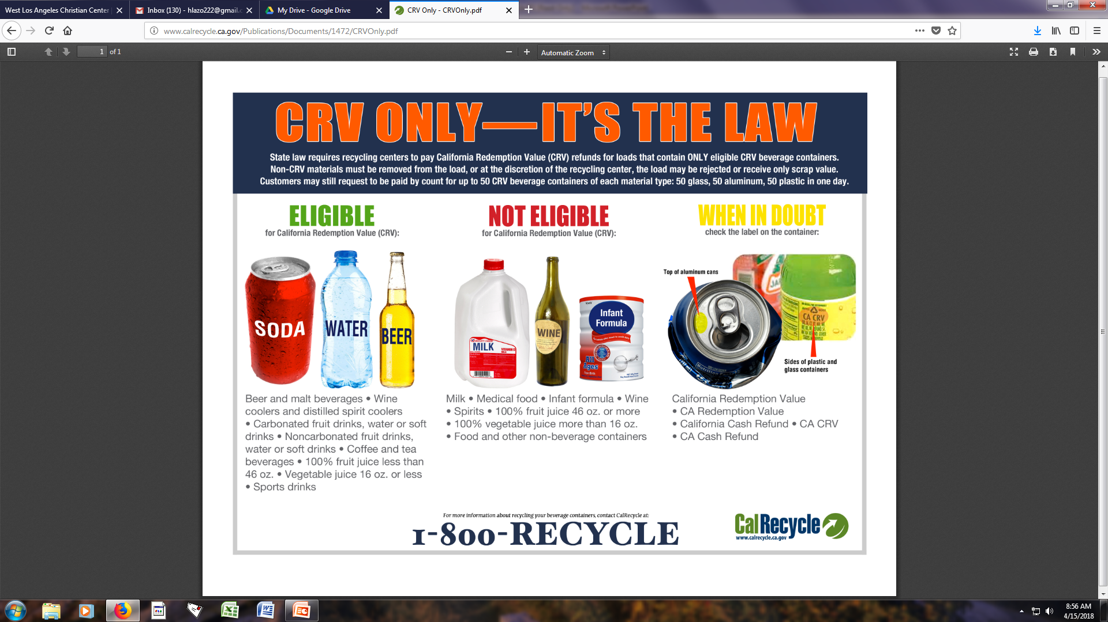
Come Grow With Us
Isaiah 11:11
Redeem

Slide 19
Come Grow With Us
Isaiah 12:1-6
Song of Praise

Slide 20
Come Grow With Us
John 15:16-17
¹⁶ You did not choose me, but I chose you and appointed you so that you might go and bear fruit—fruit that will last—and so that whatever you ask in my name the Father will give you. ¹⁷ This is my command: Love each other.

Slide 21
Come Grow With Us
We will encourage each other to find, pursue, and fulfill our God-given callings in our life (individual growth).
We will encourage others, who are currently not part of the church, to come witness and take an active part in the growth of our church (corporate growth)

