Slide 1

Come Grow With Us

Slide 2
Come Grow With Us
We will encourage each other to find, pursue, and fulfill our God-given callings in our lives (individual growth).
We will encourage others, who are currently not involved with the church, to come witness and take an active part in the growth of our church (corporate growth).

Slide 3
Come Grow With Us
3
1
2
Jesus Christ is the Center
We are stable and rooted on a strong foundation
We are the branches joined and held together by the Main Branch--Jesus

Slide 4
Come Grow With Us
4
5
The Holy Spirit is working in us and through us to fulfill the Great Commandment and the Great Commission
We are growing together in Christ bearing fruits and inviting others to also grow with us

Slide 5
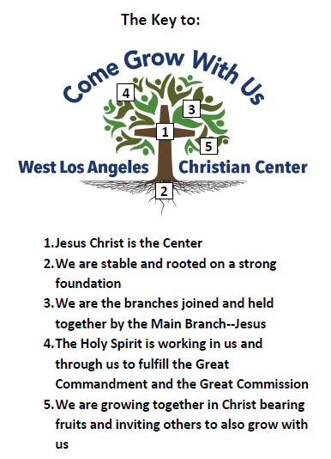
Come Grow With Us
Ephesians 4:15-16

Slide 6
Come Grow With Us
^{The Calling}
How do I find my calling?
How do I know if this is God’s calling for my life?
What do I need to do to pursue my calling?
How do I know if I am fulfilling my calling?

Slide 7
Come Grow With Us
Ephesians 4:1-2
As a prisoner for the Lord, then, I urge you to live a life worthy of the calling you have received. ² Be completely humble and gentle; be patient, bearing with one another in love.
Ephesians 4:7
⁷ But to each one of us grace has been given as Christ apportioned it.

Slide 8

Come Grow With Us
Life
Calling
Conduct Yourself
Notes:
Worthy-(Gk. axios)-'weighing as much as,' 'of like value, worth,' befitting, congruous, corresponding“
Calling (Gk. klesis)-a call, invitation to one whom God declares worthy of the calling which he has commanded to be given him, and therefore fit to obtain the blessings promised in the call

Slide 9
Come Grow With Us
1 Peter 4:9-11
¹⁰ Each of you should use whatever gift you have received to serve others, as faithful stewards of God’s grace in its various forms.
¹¹ If anyone speaks, they should do so as one who speaks the very words of God. If anyone serves, they should do so with the strength God provides, so that in all things God may be praised through Jesus Christ. To him be the glory and the power for ever and ever. Amen.

Slide 10
Come Grow With Us
1 Peter 4:9-11
¹⁰ Each of you should use whatever gift you have received to serve others, as faithful stewards of God’s grace in its various forms.
¹¹ If anyone speaks, they should do so as one who speaks the very words of God. If anyone serves, they should do so with the strength God provides, so that in all things God may be praised through Jesus Christ. To him be the glory and the power for ever and ever. Amen.

Slide 11
Come Grow With Us
Steps to find God’s Calling on Your Life
Get your life right with God
Pray and ask the Lord to reveal to you an area of gifting in your life
Begin to move and take steps of faith in serving others with your gift, even if you do not know/understand what that gift may be
Continually seek the Lord to help you develop to that gift

