Slide 1
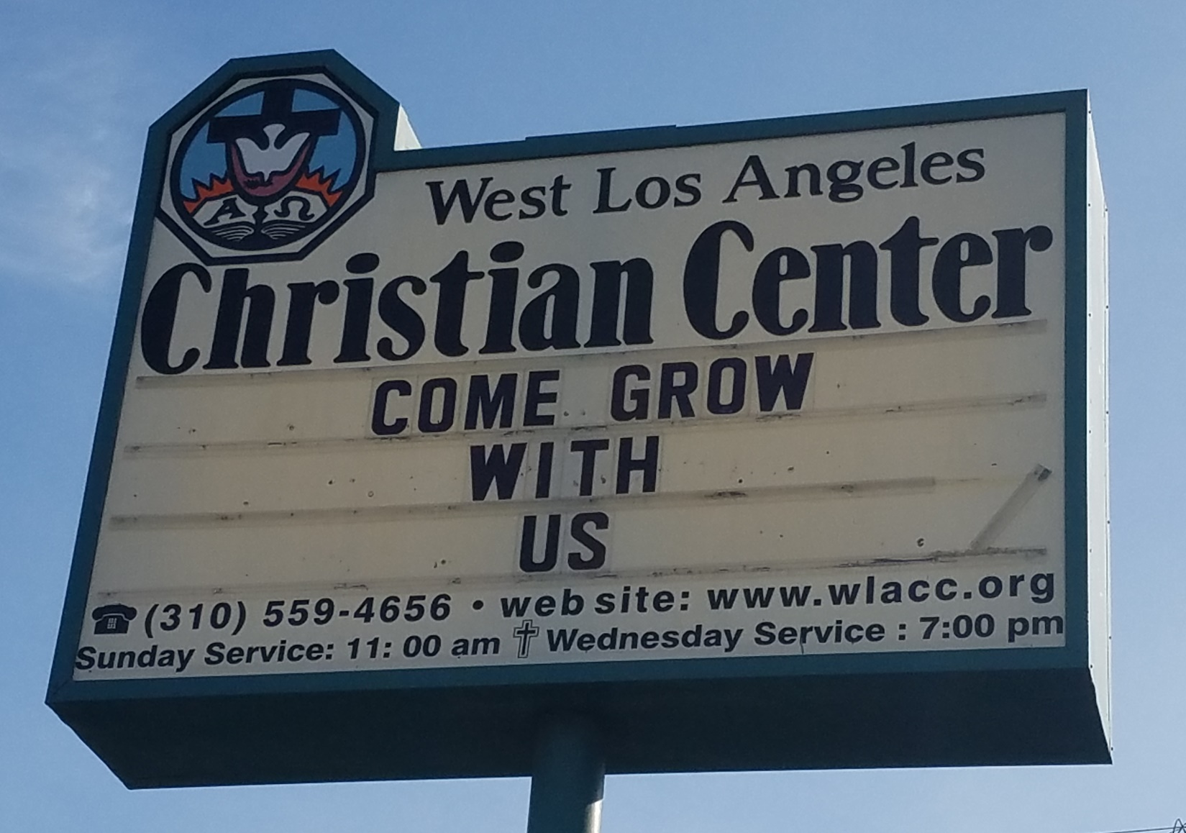
Come Grow With Us

Slide 2
Come Grow With Us
We will encourage each other to find, pursue, and fulfill our God-given callings in our lives (individual growth).
We will encourage others, who are currently not involved with the church, to come witness and take an active part in the growth of our church (corporate growth).

Slide 3
Come Grow With Us
Ephesians 4:15
¹⁵ Instead, speaking the truth in love, we will grow to become in every respect the mature body of him who is the head, that is, Christ.

Slide 4
Come Grow With Us
Ephesians 4:16
¹⁶ From him the whole body, joined and held together by every supporting ligament, grows and builds itself up in love, as each part does its work.

Slide 5


Slide 6

Come Grow With Us

Slide 7
Jesus Christ is the Center

Slide 8
We are stable and rooted on a strong foundation
1 Cor. 3:10-15
Notes:
Col. 2:5-7
Jer. 17:8
1 Cor. 3:10-15

Slide 9
Come Grow With Us
1 Cor. 3:10-15
We are stable and rooted on a strong foundation

Slide 10
We are the branches joined and held together by the Main Branch--Jesus
John 15:1-8
Notes:
John 15:1-8

Slide 11
Come Grow With Us
John 15:1-8
We are the branches joined and held together by the Main Branch--Jesus

Slide 12
The Holy Spirit is working in us and through us to fulfill the Great Commandment and the Great Commission
John 15:26-27
Notes:
John 15:26-27

Slide 13
Come Grow With Us
John 15:26-27
The Holy Spirit is working in us and through us to fulfill the Great Commandment and the Great Commission

Slide 14
We are growing together in Christ bearing fruits and inviting others to also grow with us
Ephesians 4:15-16
Notes:
Ephesians 4:15-16

Slide 15
Come Grow With Us
Ephesians 4:15-16
We are growing together in Christ bearing fruits and inviting others to also grow with us

Slide 16
Come Grow With Us
Ephesians 4:16
¹⁶ From him the whole body, joined and held together by every supporting ligament, grows and builds itself up in love, as each part does its work.

Slide 17
Come Grow With Us
Each Part Does Its Work
Pray with us “Days of Dialogue and Prayer-Wednesday Nights
Find and pursue your calling
Invite someone

