Slide 1
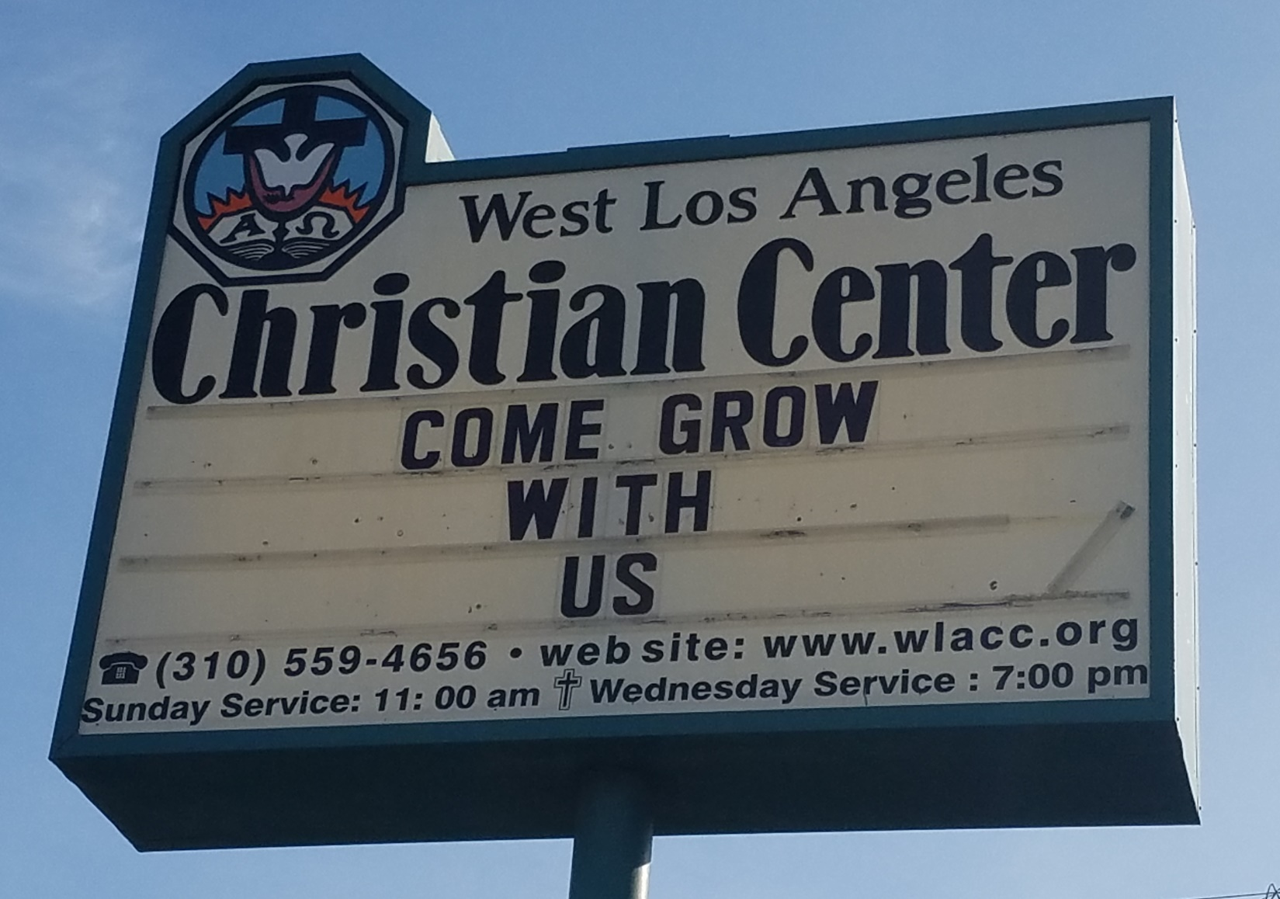
Come Grow With Us

Slide 2
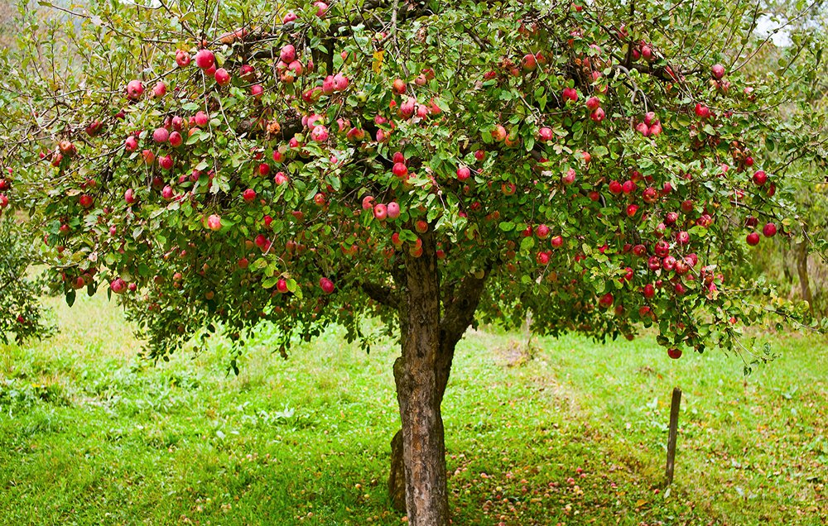
Come Grow With Us

Slide 3
Come Grow With Us
We will encourage each other to find, pursue, and fulfill our God-given callings in our lives (individual growth).
We will encourage others, who are currently not involved with the church, to come witness and take an active part in the growth of our church (corporate growth).

Slide 4
Come Grow With Us
Ephesians 4:15
¹⁵ Instead, speaking the truth in love, we will grow to become in every respect the mature body of him who is the head, that is, Christ.

Slide 5
Come Grow With Us
Ephesians 4:16
¹⁶ From him the whole body, joined and held together by every supporting ligament, grows and builds itself up in love, as each part does its work.

Slide 6
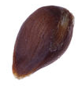
Come Grow With Us
The Seed
Genesis 1:11-12 (NLT)
¹¹Then God said, “Let the land sprout with vegetation—every sort of seed-bearing plant, and trees that grow seed-bearing fruit. These seeds will then produce the kinds of plants and trees from which they came.” And that is what happened.
¹²The land produced vegetation—all sorts of seed-bearing plants, and trees with seed-bearing fruit. Their seeds produced plants and trees of the same kind. And God saw that it was good.

Slide 7
Come Grow With Us
The Seed
zera (Heb.)
a sowing
seed
offspring
descendent
Notes:
zera (and variations of it) appears 230 times in Bible

Slide 8
The Seed
a flowering plant's unit of reproduction, capable of developing into another such plant.
the cause or latent beginning of a feeling, process, or condition.
Archaic (chiefly in biblical use) a person's offspring or descendants.
a man's semen.
a small crystal introduced into a liquid to act as a nucleus for crystallization.

Slide 9
Come Grow With Us
The Seed
Haggai 2:3
³ ‘Who of you is left who saw this house in its former glory? How does it look to you now? Does it not seem to you like nothing?

Slide 10
Come Grow With Us
The Seed
Haggai 2:6-9
⁶ “This is what the LORD Almighty says: ‘In a little while I will once more shake the heavens and the earth, the sea and the dry land. ⁷ I will shake all nations, and what is desired by all nations will come, and I will fill this house with glory,’ says the LORD Almighty. ⁸ ‘The silver is mine and the gold is mine,’ declares the LORD Almighty. ⁹ ‘The glory of this present house will be greater than the glory of the former house,’ says the LORD Almighty. ‘And in this place I will grant peace,’ declares the LORD Almighty.”

Slide 11
Come Grow With Us
The Seed
Haggai 2:18-19
¹⁸ ‘From this day on, from this twenty-fourth day of the ninth month, give careful thought to the day when the foundation of the LORD’s temple was laid. Give careful thought:
¹⁹ Is there yet any seed left in the barn? Until now, the vine and the fig tree, the pomegranate and the olive tree have not borne fruit. “ ‘From this day on I will bless you.’ ”

Slide 12
Come Grow With Us
The Seed
Zechariah 8:11-12
¹¹ But now I will not deal with the remnant of this people as I did in the past,” declares the LORD Almighty. ¹² “The seed will grow well, the vine will yield its fruit, the ground will produce its crops, and the heavens will drop their dew. I will give all these things as an inheritance to the remnant of this people.

Slide 13
Come Grow With Us
The Seed
The seed will grow well
-shalom
peace
prosperity
health
completeness
wellness
safety

Slide 14
Come Grow With Us
The Seed
1 Cor. 15: 36-38
³⁶ How foolish! What you sow does not come to life unless it dies. ³⁷ When you sow, you do not plant the body that will be, but just a seed, perhaps of wheat or of something else. ³⁸ But God gives it a body as he has determined, and to each kind of seed he gives its own body.

Slide 15
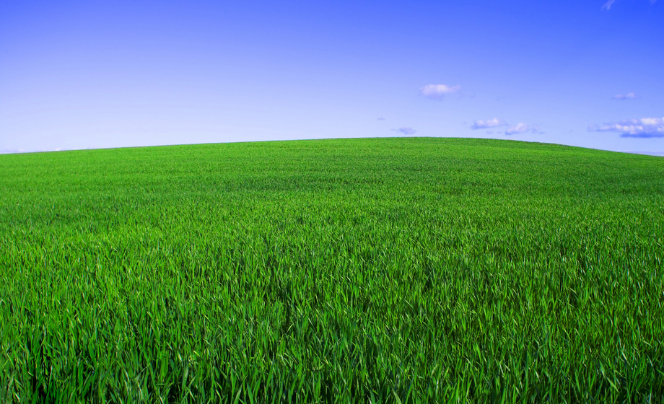
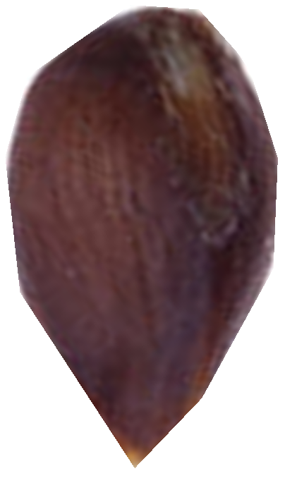
Come Grow With Us

Slide 16
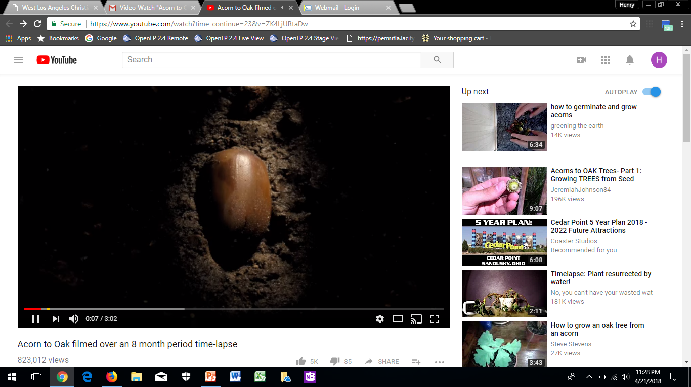
Come Grow With Us
From Seed to Plant

Slide 17
Come Grow With Us
The Seed
John 12:24 (MSG)
²⁴ "Listen carefully: Unless a grain of wheat is buried in the ground, dead to the world, it is never any more than a grain of wheat. But if it is buried, it sprouts and reproduces itself many times over.

Slide 18
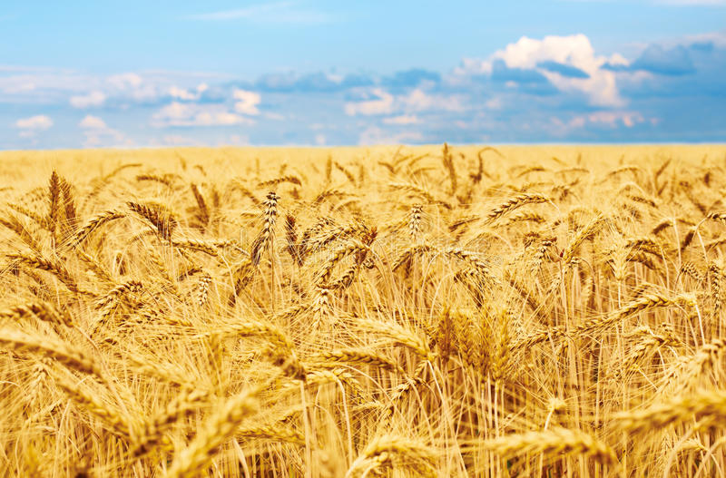
Come Grow With Us

