Slide 1
The Transformative Power Of God

Slide 2
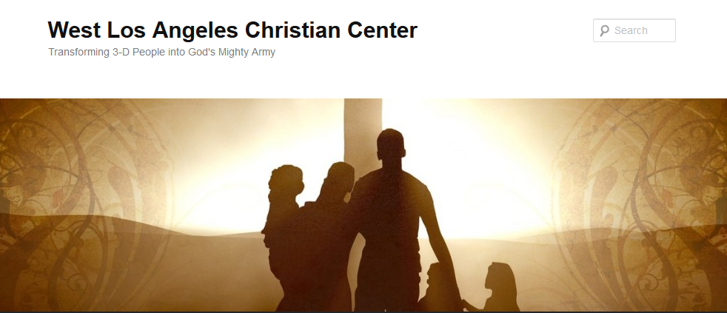
The Transformative Power of God
Transforming 3-D People into God’s Mighty Army

Slide 3
The Transformative Power of God
We at West Los Angeles Christian Center have been called by God to reach the 3-D People–Discouraged, Destitute, and Dysfunctional of the West Side of Los Angeles. Our mission is to teach, train, and equip these people so that they can be transformed into the mighty men and women of valor in God’s Army (1 Sam. 22:1-2).

Slide 4
The Transformative Power of God in Isaac
Background on Isaac
Was the promised child in which God’s covenant was to be established (Gen. 17:15-22)
Was born when Abraham was 100 years old (Gen. 21:5)
Was the sacrifice that God required of Abraham (Gen. 22:1-18)
Married Rebekah, a relative of Abraham (Gen. 24)

Slide 5
The Transformative Power of God in Isaac
Background on Isaac
Sons born when Isaac was 60 years old (Gen. 25)
    Esau (Isaac’s favorite)
    Jacob (Rebekah’s favorite)

Slide 6
The Transformative Power of God in Isaac
Isaac’s 3-D Flaws
He didn’t trust God provision (Gen. 26:1-6)
He did not learn from his father’s mistakes of lying and deception (Gen. 26: 7-11)
He made a compromise with Abimelek without seeking the Lord (Gen. 26: 26-30)
Son, Esau, married a Hittite (Gen. 26: 34-35)
His wife and son, Jacob, deceived Isaac and robbed Esau of his blessing (Gen. 27)

Slide 7
The Transformative Power of God in Isaac
Isaac’s Transformation
He was blessed by God (Gen. 26:12-14)
He became father to descendants as numerous as the stars in the sky and as countless as the sand on the seashore
He lived 180 years
His name is remembered forever as one of the three fathers—Abraham, Isaac, and Jacob—that God mentions with His name (Exod. 3:15)

Slide 8
The Transformative Power of God in Isaac
How can I relate to Isaac?
His Flaws?
His Transformation?
What is God calling me to do similar to Isaac?

