Slide 1
The Transformative Power Of God

Slide 2
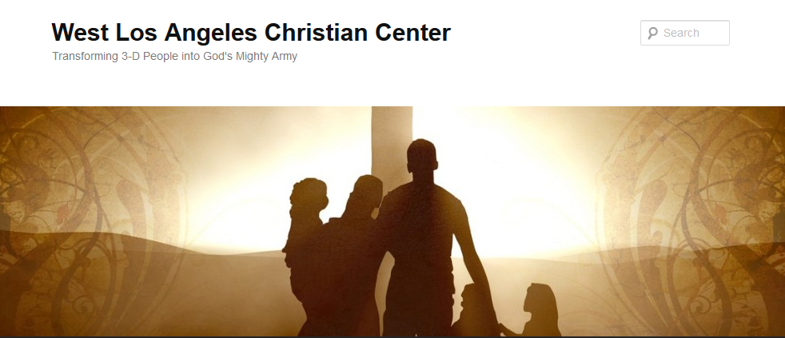
The Transformative Power of God
Transforming 3-D People into God’s Mighty Army

Slide 3
The Transformative Power of God
We at West Los Angeles Christian Center have been called by God to reach the 3-D People–Discouraged, Destitute, and Dysfunctional of the West Side of Los Angeles. Our mission is to teach, train, and equip these people so that they can be transformed into the mighty men and women of valor in God’s Army (1 Sam. 22:1-2).

Slide 4
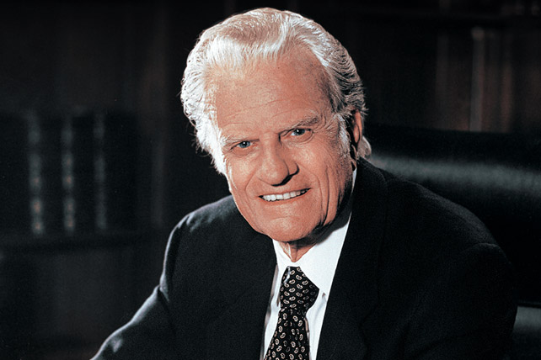
The Transformative Power of God
Billy Graham
November 7, 1918-February 21, 2018

Slide 5
The Transformative Power of God
Billy Graham
Took to heart Mark 16:15 (MSG)-” “Go into the world. Go everywhere and announce the Message of God’s good news to one and all.”
Preached the Gospel to more people in live audiences than anyone else in history—nearly 215 million people in more than 185 countries and territories
Born as a farmer boy in Charlotte, NC on November 7, 1918
1949 Los Angeles Crusade launched him into international prominence
Wrote 33 books, had multiple radio and TV shows

Slide 6
The Transformative Power of God
Billy Graham
Was listed by the Gallup Organization as one of the “Ten Most Admired Men in the World” since 1948 (61 appearances, 55th consecutive appearance in 2017
Was married to his wife, Ruth for 64 year, before she passed in 2007
Had 3 daughters, 2 sons, 19 grandchildren, and numerous great grandchildren
Lived in the mountains of North Carolina until his death on February 21, 2018

Slide 7
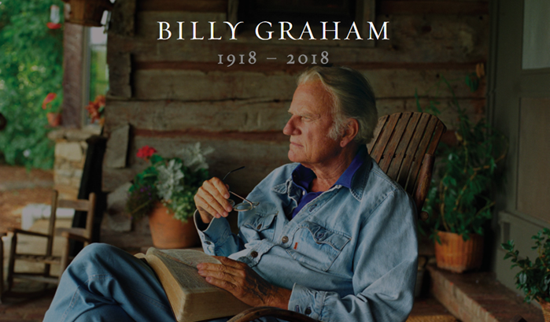
The Transformative Power of God
A Tribute to Billy Graham

Slide 8
The Transformative Power of God
Five Lessons that Billy Graham Taught Us

Slide 9
The Transformative Power of God
1. Live a Focused Life
Had only one focus in life-To preach the love of Jesus to the world
He once said: ““God proved His love on the Cross. When Christ hung, and bled, and died, it was God saying to the world, ’I love you.’”

Slide 10
The Transformative Power of God
2. Stand with Boldness
He never buckled to the pressure of political correctness
He boldly stood and proclaimed that Jesus was the Only Way

Slide 11
The Transformative Power of God
3. Practice What You
Preach
He was the epitome of integrity
He constantly surrounded himself with safeguards and accountability.
In over 60 years of ministry, there were no scandals attached to him.

Slide 12
The Transformative Power of God
4. God Does Extraordinary Things
through Ordinary People
Even though he was a larger than life figure, he was always a Daddy, farmer at heart, who loved his cats and dogs
He wore old blue jeans, comfortable sweaters, and a baseball cap
He loved lukewarm coffee, sweet ice tea, one scoop of ice cream and a plain hamburger from McDonald’s

Slide 13
The Transformative Power of God
5. There are No Perfect
People
He was a godly man but not a perfect man
His greatest regret-not spending enough time with his children
He was gone 60% of time when kids were growing up
No one is perfect, and everyone needs Jesus

Slide 14
The Transformative Power of God
Live a Focused Life
Stand with Boldness
Practice What You Preach
God Does Extraordinary Things through Ordinary People
There are No Perfect People

Slide 15
The Transformative Power of God
¹⁵ He said to them, “Go into all the world and preach the gospel to all creation.¹⁶ Whoever believes and is baptized will be saved, but whoever does not believe will be condemned. ¹⁷ And these signs will accompany those who believe: In my name they will drive out demons; they will speak in new tongues; ¹⁸ they will pick up snakes with their hands; and when they drink deadly poison, it will not hurt them at all; they will place their hands on sick people, and they will get well.” (Mark 16:15-18)

Slide 16
The Transformative Power of God
Billy Graham
November 7, 1918-February 21, 2018

