Slide 1
The Transformative Power Of God

Slide 2
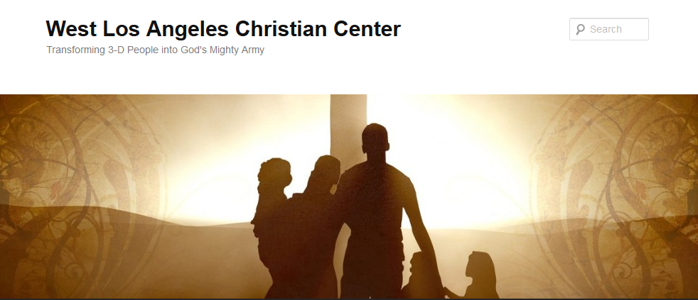
The Transformative Power of God
Transforming 3-D People into God’s Mighty Army

Slide 3
The Transformative Power of God
We at West Los Angeles Christian Center have been called by God to reach the 3-D People–Discouraged, Destitute, and Dysfunctional of the West Side of Los Angeles. Our mission is to teach, train, and equip these people so that they can be transformed into the mighty men and women of valor in God’s Army (1 Sam. 22:1-2).

Slide 4
The Transformative Power of God
Where is God’s transformation when evil or tragedy happens?

Slide 5
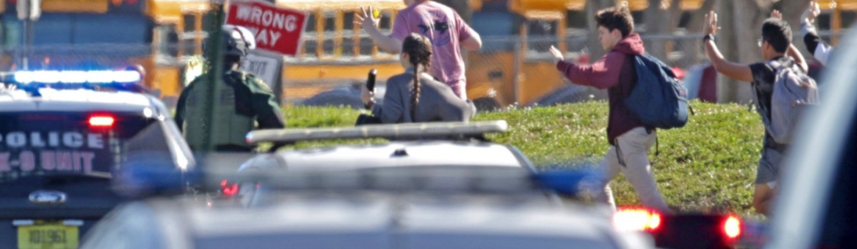
Florida School Shooting

Slide 6
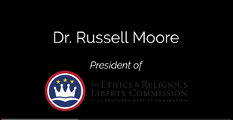
The Transformative Power of God
Interview with Dr. Russell Moore

Slide 7
The Transformative Power of God
What lessons can we learn?

Slide 8
The Transformative Power of God
How does this and other incidents such as this transform me?

Slide 9
The Transformative Power of God
How do we pray?

