Slide 1
The Transformative Power Of God

Slide 2
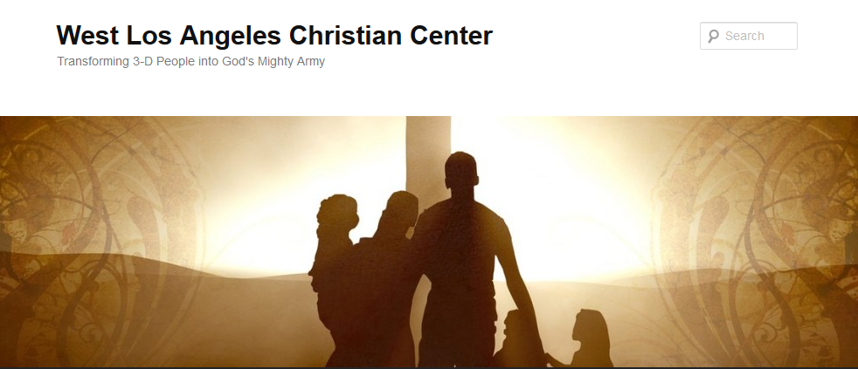
The Transformative Power of God
Transforming 3-D People into God’s Mighty Army

Slide 3
The Transformative Power of God
We at West Los Angeles Christian Center have been called by God to reach the 3-D People–Discouraged, Destitute, and Dysfunctional of the West Side of Los Angeles. Our mission is to teach, train, and equip these people so that they can be transformed into the mighty men and women of valor in God’s Army (1 Sam. 22:1-2).

Slide 4
The Transformative Power of God in Abraham
Abraham’s 3-D Flaws
He didn’t trust God (Gen. 17:17-18)
He questioned God and tried to cut deals with Him (Gen. 18: 22-33)
He lied to get out of situations (Gen. 20:1-2, 12)
He didn’t protect his wife
He deceived others (Gen. 21:22-23)
He took advantage of others (Gen. 21:24-26)
His family members followed his footsteps

Slide 5
The Transformative Power of God in Abraham
Abraham’s Transformation (Heb. 11)
He obeyed and went (v. 8)
He made his home in the promised land (v. 9)
He became father to descendants as numerous as the stars in the sky and as countless as the sand on the seashore (v. 12)
When God tested him, he offered Isaac as a sacrifice (v. 17)
He embraced the promises (v. 17)
He reasoned that God could even raise the dead (v. 19)

Slide 6
The Transformative Power of God in Abraham
How can I relate to Abraham?
His Flaws?
His Transformation?
What is God calling me to do similar to Abraham?

