Slide 1
The Transformative Power Of God

Slide 2
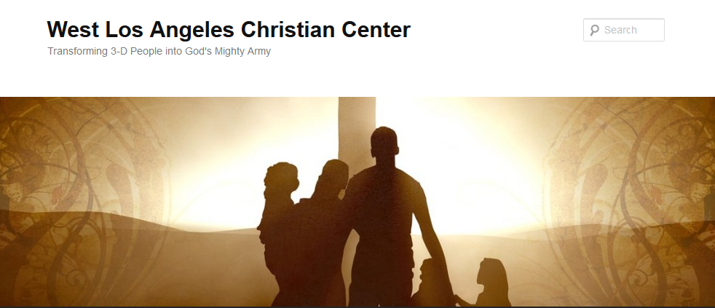
The Transformative Power of God
Transforming 3-D People into God’s Mighty Army

Slide 3
The Transformative Power of God
We at West Los Angeles Christian Center have been called by God to reach the 3-D People–Discouraged, Destitute, and Dysfunctional of the West Side of Los Angeles. Our mission is to teach, train, and equip these people so that they can be transformed into the mighty men and women of valor in God’s Army (1 Sam. 22:1-2).

Slide 4
The Transformative Power of God
Transform-v.
to change in form, appearance, or structure; metamorphose.
to change in condition, nature, or character; convert.
to change into another substance; transmute.

Slide 5
The Transformative Power of God
1 Cor. 1:26-29
²⁶ Brothers and sisters, think of what you were when you were called. Not many of you were wise by human standards; not many were influential; not many were of noble birth. ²⁷ But God chose the foolish things of the world to shame the wise; God chose the weak things of the world to shame the strong. ²⁸ God chose the lowly things of this world and the despised things—and the things that are not—to nullify the things that are, ²⁹ so that no one may boast before him.

Slide 6
The Transformative Power of God in Noah
Noah (Gen. 6:9-22)
Righteous man
Blameless among the people
Walked faithfully with God
Did everything just as God commanded him

Slide 7
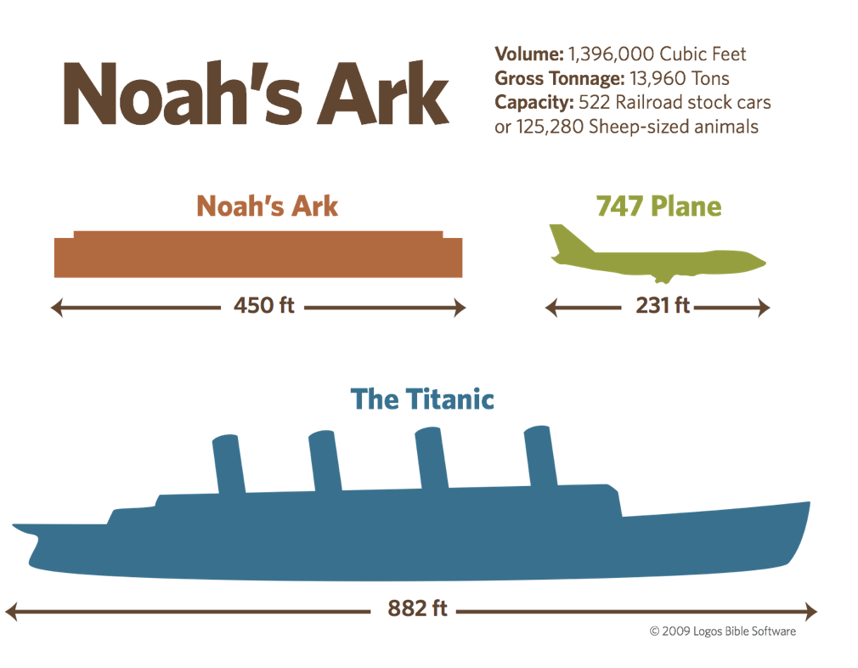
The Transformative Power of God in Noah

Slide 8
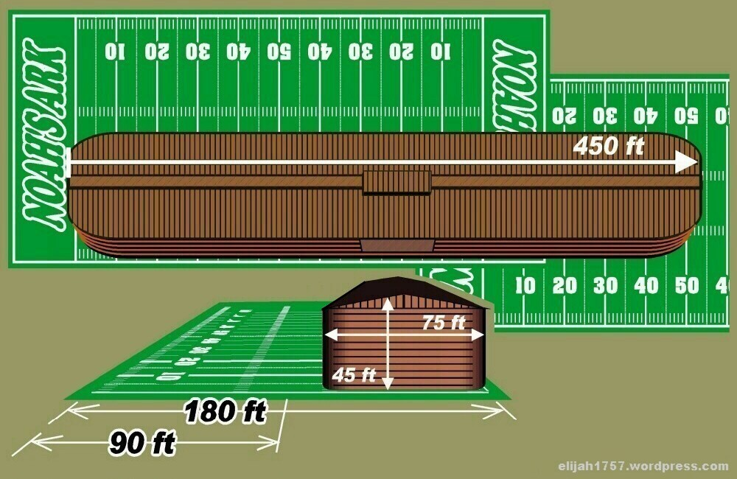
The Transformative Power of God in Noah

Slide 9
The Transformative Power of God in Noah and His Family
Noah’s Family
(Gen. 6:18)
But I will establish my covenant with you, and you will enter the ark—you and your sons and your wife and your sons’ wives with you.

Slide 10
The Transformative Power of God in Noah and His Family
Noah’s Family
(Gen. 7:1)
¹The Lord then said to Noah, “Go into the ark, you and your whole family, because I have found you righteous in this generation.

Slide 11
The Transformative Power of God in Noah and His Family
Noah’s Family
(Gen. 7:7)
⁷ And Noah and his sons and his wife and his sons’ wives entered the ark to escape the waters of the flood.

Slide 12
The Transformative Power of God in Noah and His Family
Noah’s Family
(Gen. 8:18)
¹⁸ So Noah came out, together with his sons and his wife and his sons’ wives.

Slide 13
The Transformative Power of God in Noah and His Family
Noah’s Family
(Gen. 9:8-9)
⁸ Then God said to Noah and to his sons with him: ⁹ “I now establish my covenant with you and with your descendants after you

Slide 14
The Transformative Power of God in Noah and His Family
Noah’s Family
(Hebrews 11:7
⁷ By faith Noah, when warned about things not yet seen, in holy fear built an ark to save his family. By his faith he condemned the world and became heir of the righteousness that is in keeping with faith.

Slide 15
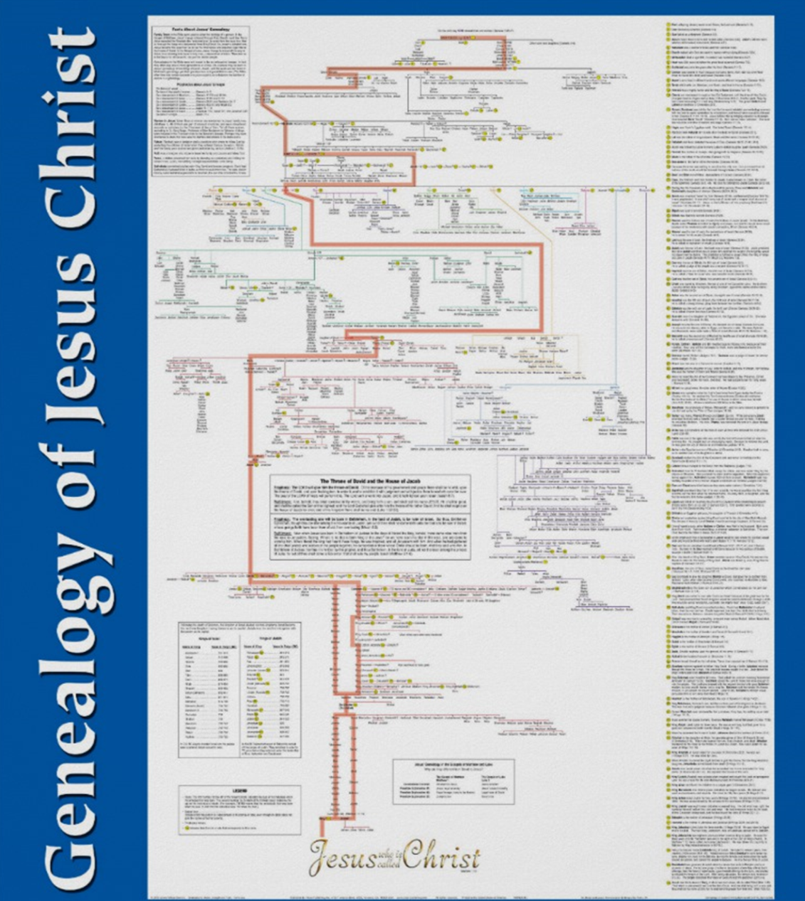
The Transformative Power of God

Slide 16
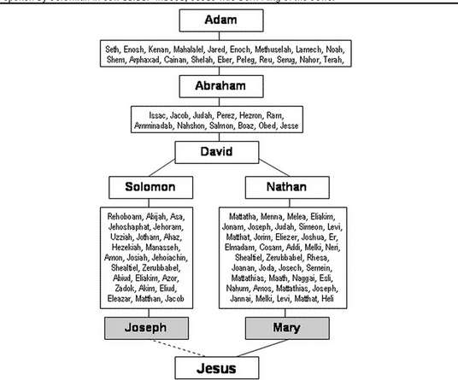
The Transformative Power of God

Slide 17
The Transformative Power of God in Noah and My Family
My Family
Are you staying obedient to the Lord and blameless in the sight of men?
Where does your family fit in terms of the vision/direction that God has given you?
Do you have enough faith to believe that God will save you and your family?

