Slide 1
The Transformative Power Of God

Slide 2
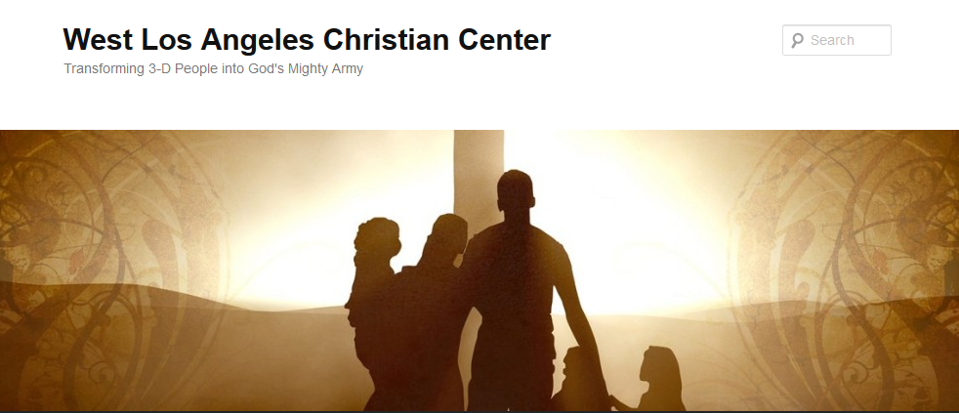
The Transformative Power of God
Transforming 3-D People into God’s Mighty Army

Slide 3
The Transformative Power of God
We at West Los Angeles Christian Center have been called by God to reach the 3-D People–Discouraged, Destitute, and Dysfunctional of the West Side of Los Angeles. Our mission is to teach, train, and equip these people so that they can be transformed into the mighty men and women of valor in God’s Army (1 Sam. 22:1-2).

Slide 4
The Transformative Power of God
Transform-v.
to change in form, appearance, or structure; metamorphose.
to change in condition, nature, or character; convert.
to change into another substance; transmute.

Slide 5
The Transformative Power of God
1 Cor. 1:26-29 ²⁶ Brothers and sisters, think of what you were when you were called. Not many of you were wise by human standards; not many were influential; not many were of noble birth. ²⁷ But God chose the foolish things of the world to shame the wise; God chose the weak things of the world to shame the strong. ²⁸ God chose the lowly things of this world and the despised things—and the things that are not—to nullify the things that are, ²⁹ so that no one may boast before him.

Slide 6
The Transformative Power of God
1 Cor. 1:30-31 ³⁰ It is because of him that you are in Christ Jesus, who has become for us wisdom from God—that is, our righteousness, holiness and redemption. ³¹ Therefore, as it is written: “Let the one who boasts boast in the Lord.”

Slide 7
The Transformative Power of God
2 Cor. 12:9-10 ⁹ But he said to me, “My grace is sufficient for you, for my power is made perfect in weakness.” Therefore I will boast all the more gladly about my weaknesses, so that Christ’s power may rest on me. ¹⁰ That is why, for Christ’s sake, I delight in weaknesses, in insults, in hardships, in persecutions, in difficulties. For when I am weak, then I am strong.

Slide 8
The Transformative Power of God
“Everyone that God used significantly there was a common denominator and it wasn’t their training or personality, it was that little phrase ‘“God was with him.”
-Daniel Henderson

Slide 9
The Transformative Power of God in Adam
Adam’s (Gen. 1 and 2)
First man
Ruler over all creatures
Created in God’s Image
Formed out of dust and given life by God
Placed in Garden of Eden to take care of it
Given authority to name all of the animals

Slide 10
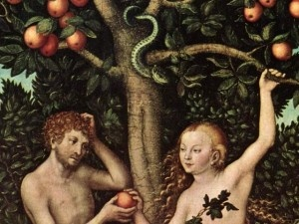
The Transformative Power of God in Adam

Slide 11
The Transformative Power of God in Adam
Adam’s Flaws (Gen. 3:1-6)
He allowed the serpent to talk to his wife
He did not protect his wife from harm and deception
He did not speak up or do something when he knew that something was wrong
He not only saw his wife doing wrong but also willfully and knowingly took part

Slide 12
The Transformative Power of God in Adam
Adam’s Response (Gen. 3:7-13)
They tried to clothe their nakedness
They tried to hide from God
He lied to God or gave only part of the truth
He blamed his wife instead of taking responsibility

Slide 13
The Transformative Power of God in Adam
Adam’s Transformation (Gen. 3:17-24)
God clearly told Adam what he did wrong
God provided consequences for Adam’s choices and actions
God clothe Adam and Eve with animal skins
God made plans for redemption and prevented Adam and Eve from being eternally separated from Him

Slide 14
The Transformative Power of God in Adam
Adam’s Transformation-The Outcome
Adam and Eve were used by God to populate the earth
Adam lived to the age of 930 (Gen. 5:3)
Adam is the first person in the lineage of Jesus (Luke 3:23-38 not Matthew 1)
Adam became the example for us of who we are as men

Slide 15
The Transformative Power of God in Us
1 Cor. 15:45-48
⁴⁵ So it is written: “The first man Adam became a living being”^{[f]}; the last Adam, a life-giving spirit. ⁴⁶ The spiritual did not come first, but the natural, and after that the spiritual. ⁴⁷ The first man was of the dust of the earth; the second man is of heaven. ⁴⁸ As was the earthly man, so are those who are of the earth; and as is the heavenly man, so also are those who are of heaven.

Slide 16
The Transformative Power of God in Us
We are being transformed from:
Earthly man → Heavenly Man
Image of man → Image of God
Adam → Jesus
Led by feelings → Led by Spirit
“psyche” → “pneuma”

Slide 17
The Transformative Power of God in Us
Do you believe that God want to transform us?
What does He want to change in us this year?
How does he want us to cause transformation in others?

