Slide 1
The Transformative Power Of God

Slide 2
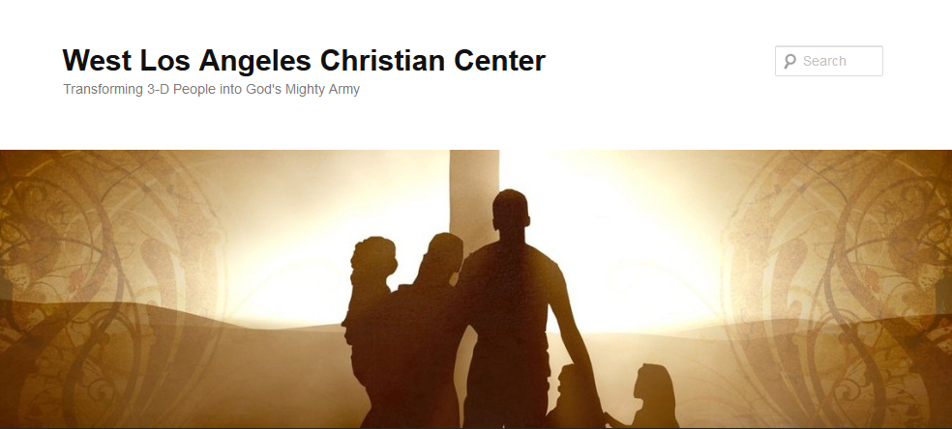
The Transformative Power of God

Slide 3
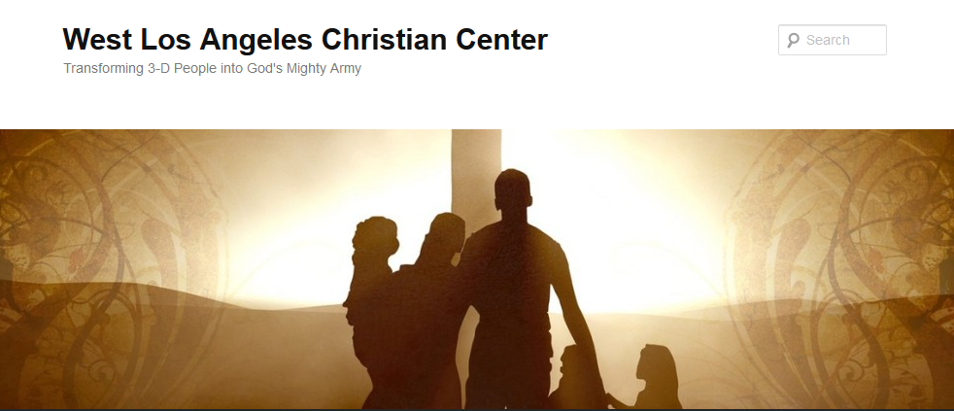
The Transformative Power of God
Transforming 3-D People into God’s Mighty Army

Slide 4
The Transformative Power of God
We at West Los Angeles Christian Center have been called by God to reach the 3-D People–Discouraged, Destitute, and Dysfunctional of the West Side of Los Angeles. Our mission is to teach, train, and equip these people so that they can be transformed into the mighty men and women of valor in God’s Army (1 Sam. 22:1-2).

Slide 5
The Transformative Power of God
Transform-v.
to change in form, appearance, or structure; metamorphose.
to change in condition, nature, or character; convert.
to change into another substance; transmute.

Slide 6
The Transformative Power of God
Transformative-adj.
causing a marked change in someone or something.
causing a major change to something or someone, especially in a way that makes it or them better

Slide 7
The Transformative Power of God
Synonyms
  Born-again
  Cathartic
  Life-changing
  Metamorphic
  Reframing
  Transformational
  Transmuting

Slide 8
The Transformative Power of God
Antonyms
  Everyday
  Ordinary
  Uneventful

Slide 9
The Transformative Power of God
The Plan
Study people in the Bible who God has transformed
Look at ourselves and at how God has and how He will transform us
Look at others around us and determine how God wants to use us to help in the transformation of their lives

Slide 10
The Transformative Power of God
1 Cor. 1:26-29
²⁶ Brothers and sisters, think of what you were when you were called. Not many of you were wise by human standards; not many were influential; not many were of noble birth. ²⁷ But God chose the foolish things of the world to shame the wise; God chose the weak things of the world to shame the strong. ²⁸ God chose the lowly things of this world and the despised things—and the things that are not—to nullify the things that are, ²⁹ so that no one may boast before him.

Slide 11

The Transformative Power of God
Unleash the Superhero in You

Slide 12
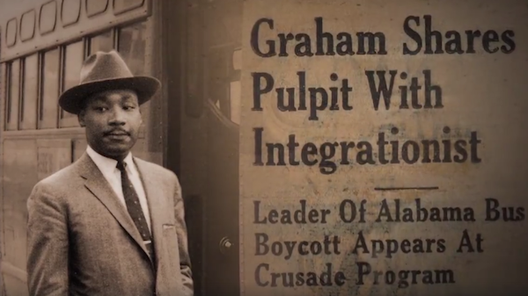
The Transformative Power of God
Christian Super Heroes
Dr. Martin Luther King
and
Billy Graham

Slide 13
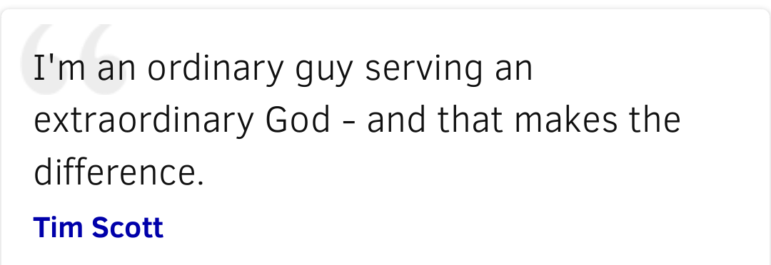
The Transformative Power of God

Slide 14
The Transformative Power of God
“Everyone that God used significantly there was a common denominator and it wasn’t their training or personality, it was that little phrase ‘“God was with him.”
-Daniel Henderson

