Slide 1
The Transformative Power Of God

Slide 2
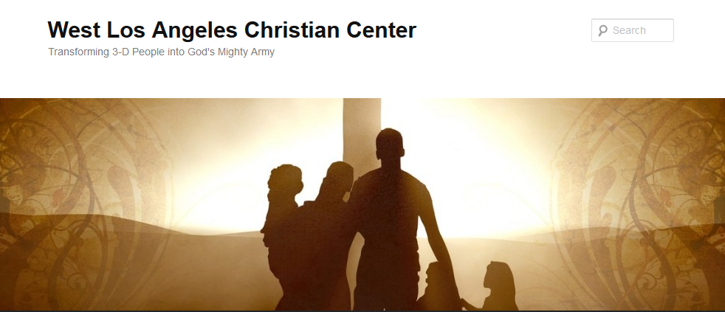
The Transformative Power of God
Transforming 3-D People into God’s Mighty Army

Slide 3
The Transformative Power of God
We at West Los Angeles Christian Center have been called by God to reach the 3-D People–Discouraged, Destitute, and Dysfunctional of the West Side of Los Angeles. Our mission is to teach, train, and equip these people so that they can be transformed into the mighty men and women of valor in God’s Army (1 Sam. 22:1-2).

Slide 4
Difference between Change and Transformation
Change
Swapping one identity for another.
Moving from one job to another job.
Going from a big corporation to a smaller business.
Moving from one place to another.
Changing roles from one to another.

Slide 5
Difference between Change and Transformation
Transformation
May encompass change
It’s bigger and scarier than change.
While change happens around us, transformation happens inside us.
Look at transformation between caterpillar and butterfly

Slide 6
Difference between Change and Transformation
Change
With change, we adapt to it.
We find the inner strength and resilience to persist despite the tumultuous environment around us.

Slide 7
Difference between Change and Transformation
Transformation
Happens to us.
It’s we who become changed
The storm is within, mutilating and reshaping us from the inside out.
Inner strength isn’t found by trying harder or hacking your way there.
Strength is found in a willingness to let it all go, surrender to the storm, and journey toward a destination unknown.

Slide 8

The Transformative Power of God
How a Caterpillar Becomes a Butterfly

Slide 9
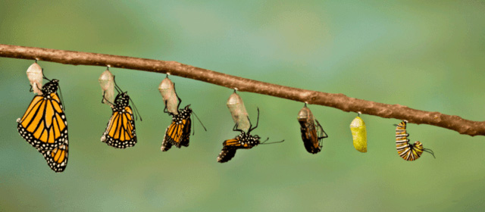
The Transformative Power of God

Slide 10
The Transformative Power of God in Jesus
Isaiah 53:1-10

Slide 11
The Transformative Power of God in Us
1 Corinthians 9:19-23

Slide 12
The Transformative Power of God in Us
What did Jesus model for us in terms of transformation?
What is it that we believe that God want to transform us into?
How are we allowing God to do that in our lives?
How will our transformation have an impact on the people around us?

