Slide 1
The Transformative Power Of God

Slide 2
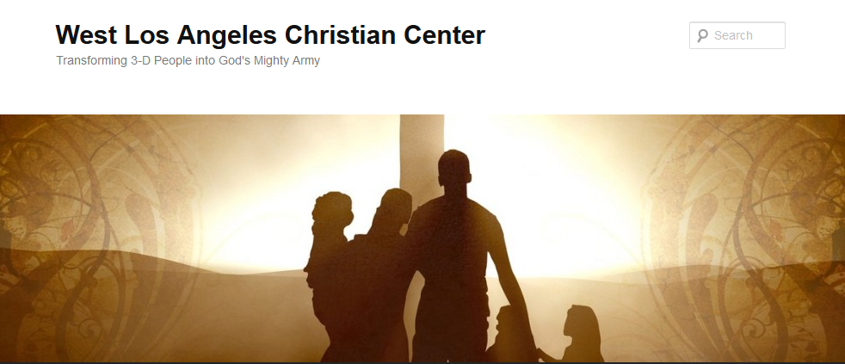
The Transformative Power of God
Transforming 3-D People into God’s Mighty Army

Slide 3
The Transformative Power of God
We at West Los Angeles Christian Center have been called by God to reach the 3-D People–Discouraged, Destitute, and Dysfunctional of the West Side of Los Angeles. Our mission is to teach, train, and equip these people so that they can be transformed into the mighty men and women of valor in God’s Army (1 Sam. 22:1-2).

Slide 4
The Transformative Power of God
Transforming to Become More Like Jesus
Video-Michael Jr.
“What if you were a Younger Sibling of Jesus?”

Slide 5
The Transformative Power of God
Transform-v.
to change in form, appearance, or structure; metamorphose.
to change in condition, nature, or character; convert.
to change into another substance; transmute.

Slide 6
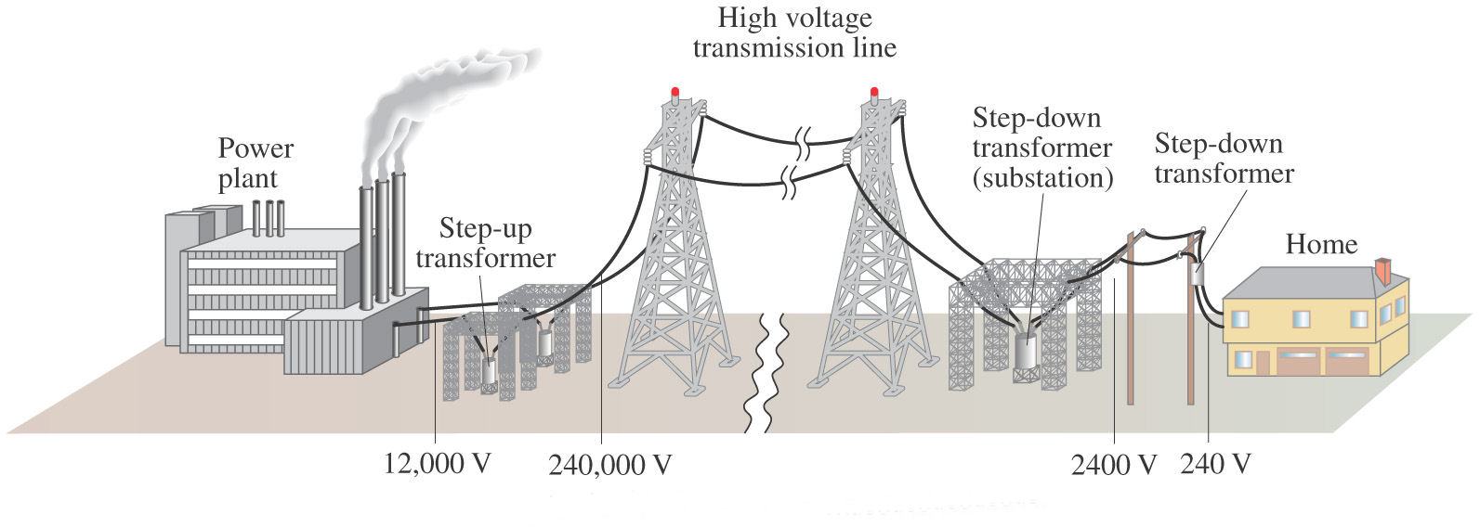
The Transformative Power of God
Transformers (In Electricity)

Slide 7
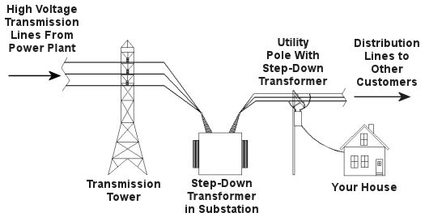
The Transformative Power of God
Transformers (In Electricity)

Slide 8
The Transformative Power of God in Jesus
Phil. 2:5 (NIV)
⁵ In your relationships with one another, have the same mindset as Christ Jesus:
Rom. 12:2
² Do not conform to the pattern of this world, but be transformed by the renewing of your mind. Then you will be able to test and approve what God’s will is—his good, pleasing and perfect will.

Slide 9
The Transformative Power of God in Jesus
Phil. 2:5-7 (NIV)
⁵ In your relationships with one another, have the same mindset as Christ Jesus:
⁶ Who, being in very nature God, did not consider equality with God something to be used to his own advantage; ⁷ rather, he made himself nothing by taking the very nature of a servant, being made in human likeness.

Slide 10
The Transformative Power of God in Jesus
Phil. 2:5-6 (AMP)
⁵ Have this same attitude in yourselves which was in Christ Jesus [look to Him as your example in selfless humility], ⁶ who, although He existed in the form and unchanging essence of God [as One with Him, possessing the fullness of all the divine attributes—the entire nature of deity], did not regard equality with God a thing to be grasped or asserted [as if He did not already possess it, or was afraid of losing it];

Slide 11
The Transformative Power of God in Jesus
Phil. 2:7 (AMP)
⁷ but emptied Himself [without renouncing or diminishing His deity, but only temporarily giving up the outward expression of divine equality and His rightful dignity] by assuming the form of a bond-servant, and being made in the likeness of men [He became completely human but was without sin, being fully God and fully man].
emptied himself-(Gk. kenoó) to make empty, deprive of content, make unreal, remove reputation

Slide 12
The Transformative Power of God in Jesus
Phil. 2:8 (AMP)
⁸ After He was found in [terms of His] outward appearance as a man [for a divinely-appointed time], He humbled Himself [still further] by becoming obedient [to the Father] to the point of death, even death on a cross.
humbled himself-(Gk. tapeinoó) to bring into it humble condition, reduce to meaner circumstances, to assign a lower rank or place to, to be ranked below others who are honored or rewarded

Slide 13
The Transformative Power of God in Jesus
Phil. 2:9-11
⁹ Therefore God exalted him to the highest place and gave him the name that is above every name, ¹⁰ that at the name of Jesus every knee should bow, in heaven and on earth and under the earth, ¹¹ and every tongue acknowledge that Jesus Christ is Lord, to the glory of God the Father.

Slide 14
The Transformative Power of God in Jesus
What was the mindset of Jesus when He came to this earth?
Do I have that same mindset?
What am I doing to prepare for Easter Sunday-- the celebration of Jesus’ Ultimate Transformation?

