Slide 1
The Transformative Power Of God

Slide 2
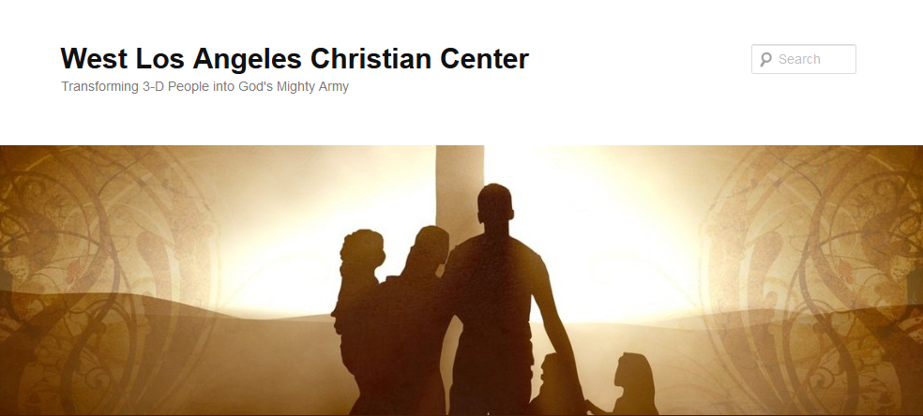
The Transformative Power of God

Slide 3
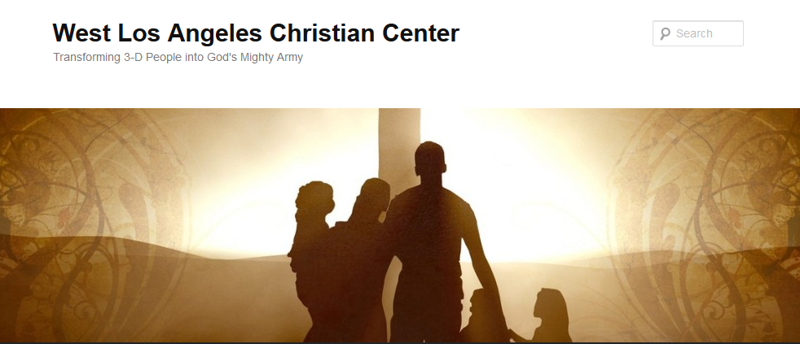
The Transformative Power of God
Transforming 3-D People into God’s Mighty Army

Slide 4
The Transformative Power of God
Transform-v.
to change in form, appearance, or structure; metamorphose.
to change in condition, nature, or character; convert.
to change into another substance; transmute.

Slide 5
The Transformative Power of God
Transformative-adj.
causing a marked change in someone or something.
causing a major change to something or someone, especially in a way that makes it or them better

Slide 6
The Transformative Power of God
Synonyms
Born-again
Cathartic
Life-changing
Metamorphic
Reframing
Transformational
Transmuting

Slide 7
The Transformative Power of God
Antonyms
Everyday
Ordinary
Uneventful

Slide 8
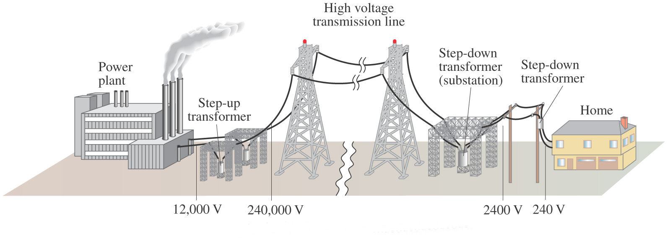
The Transformative Power of God
Transformers (In Electricity)

Slide 9


The Transformative Power of God

Slide 10

The Transformative Power of God
Unleash the Superhero in You

Slide 11
The Transformative Power of God
We at West Los Angeles Christian Center have been called by God to reach the 3-D People–Discouraged, Destitute, and Dysfunctional of the West Side of Los Angeles. Our mission is to teach, train, and equip these people so that they can be transformed into the mighty men and women of valor in God’s Army (1 Sam. 22:1-2).

Slide 12
The Transformative Power of God
The Plan
Study people in the Bible who God has transformed
Look at ourselves and at how God has and how He will transform us
Look at others around us and determine how God wants to use us to help in the transformation of their lives

Slide 13
The Transformative Power of God
2 Cor. 5:17 Therefore, if anyone is in Christ, the new creation has come: The old has gone, the new is here!

Slide 14
The Transformative Power of God
John 14:12 Very truly I tell you, whoever believes in me will do the works I have been doing, and they will do even greater things than these, because I am going to the Father.

Slide 15
The Transformative Power of God
Romans 6:4 We therefore were buried with Him through baptism into death, in order that, just as Christ was raised from the dead through the glory of the Father, we too may walk in newness of life.

Slide 16
The Transformative Power of God
1 Cor. 1:26-29 ²⁶ Brothers and sisters, think of what you were when you were called. Not many of you were wise by human standards; not many were influential; not many were of noble birth. ²⁷ But God chose the foolish things of the world to shame the wise; God chose the weak things of the world to shame the strong. ²⁸ God chose the lowly things of this world and the despised things—and the things that are not—to nullify the things that are, ²⁹ so that no one may boast before him.

Slide 17
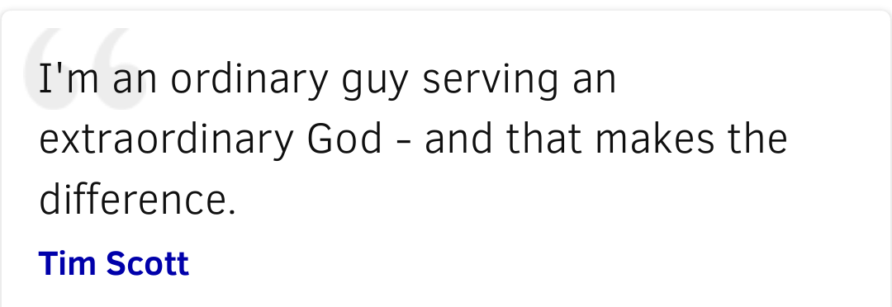
The Transformative Power of God

Slide 18

The Transformative Power of God

